Slide 1
Machine Learning and Wi-Fi:
Confluences, Ongoing Activities, and Ways Forward
https://mlwifitutorial.github.io/
Francesc Wilhelmi, Szymon Szott, Katarzyna Kosek-Szott, Boris Bellalta
October 6th, 2023
ACM Mobicom
Notes:
Boris: part 1 and one example in part 2
Szymon: example in part 1 and rest of part 2 and part 3
Target time: 90 minutes total
Boris
Welcome. It’s a pleasure to give this tutorial in this meeting. Thanks for inviting us.
In this talk, we aim to provide a brief and concise overview of standard ML techniques, as well as how they have been applied to Wi-Fi by the research community in the last years. We hope you will find it interesting.

Slide 2
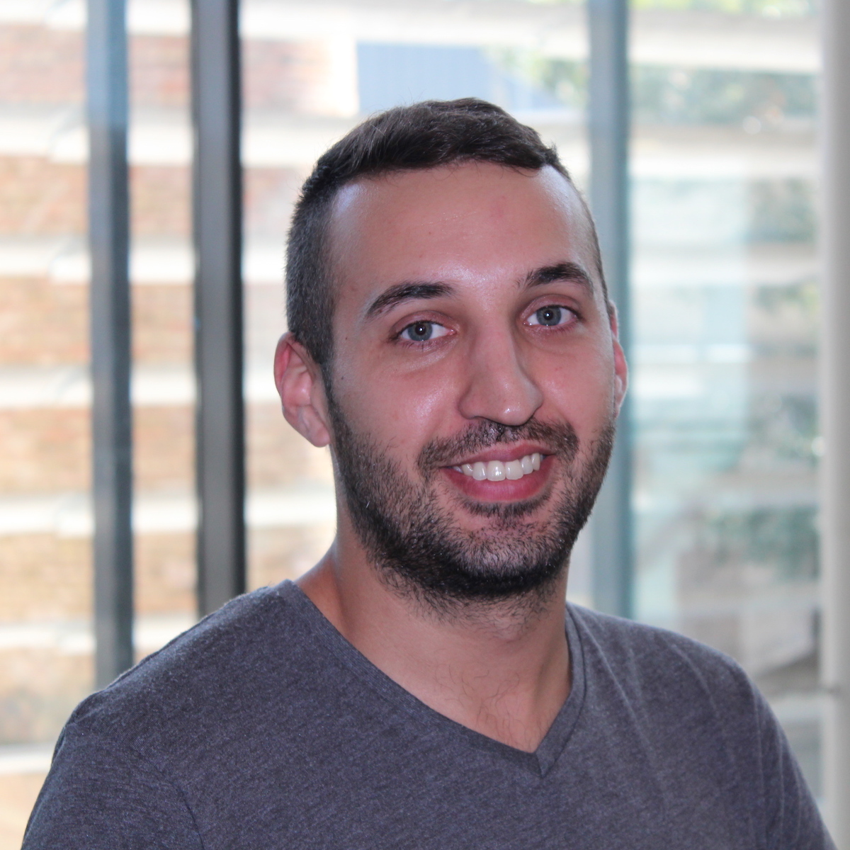

Francesc Wilhelmi
Research Engineer at Radio Systems Research (RSR), Nokia Bell-Labs Germany
PhD from Universitat Pompeu Fabra (UPF)
Interests:
Wi-Fi networks & unlicensed wireless technologies
AIML for communications
DLT & blockchain
Contact: francisco.wilhelmi@nokia.com
Notes:
Boris
I’m a full professor at UPF, where I head the wireless networking group. Our work focuses on wireless networks operating in unlicensed bands, and so in Wi-Fi as the most successful Internet access technology working there.
I became interested in ML techniques to see if using them we could improve Wi-Fi performance. My personal interests are mainly on low complexity Reinforcement Learning agents to deal with coexistence problems in dense Wi-Fi networks.

Slide 3


Szymon Szott
Associate professor at AGH University of Kraków, Poland
Research interests
Wireless local area networks
Channel access
Quality of service
Security
Inter-technology coexistence
ML interest: clever ways to improve performance
Contact:
szott@agh.edu.pl
https://szymonszott.github.io/
Notes:
Szymon
I’m an associate professor at AGH University in Kraków, Poland
I’m mostly interested in channel access methods for improving Wi-Fi performance and I believe ML methods can provide clever means in certain cases.

Slide 4

Katarzyna Kosek-Szott
Associate Professor at AGH University of Krakow, Poland
Main research interests
Novel IEEE 802.11 amendments
Coexistence of radio technologies in unlicensed bands
Application of ML in IEEE 802.11 networks
Contact: kks@agh.edu.pl
Notes:
Katarzyna
I’m an associate professor at AGH University in Kraków, Poland
My major interests are…

Slide 5


Boris Bellalta
Full-professor at UPF
Head of the Wireless Networking group
Unlicensed bands, Wi-Fi
XR Immersive Communications (over Wi-Fi)
ML interest: ‘intelligent’ adaptive systems; low-complexity but responsive RL agents; interplay between ML agents;
Contact: boris.bellalta@upf.edu
Notes:
Boris
I’m a full professor at UPF, where I head the wireless networking group. Our work focuses on wireless networks operating in unlicensed bands, and so in Wi-Fi as the most successful Internet access technology working there.
I became interested in ML techniques to see if using them we could improve Wi-Fi performance. My personal interests are mainly on low complexity Reinforcement Learning agents to deal with coexistence problems in dense Wi-Fi networks.

Slide 6

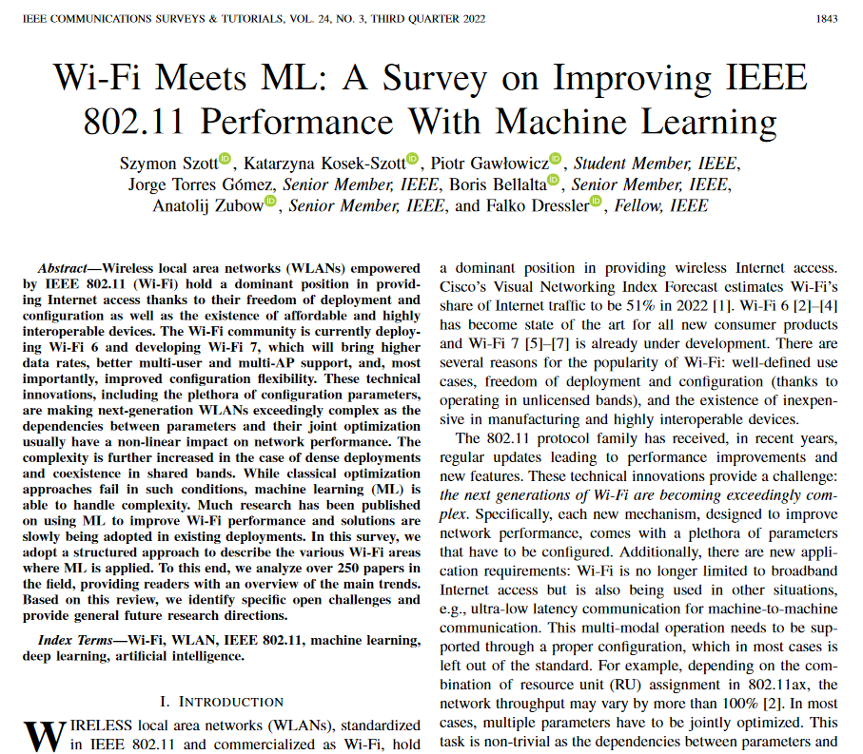

Acknowledgements
Piotr Gawłowicz, Jorge Torres Gómez, Anatolij Zubow, Falko Dressler, co-authors of the survey paper “Wi-Fi Meets ML: A Survey on Improving IEEE 802.11 Performance with Machine Learning” in IEEE Communications Surveys & Tutorials, vol. 24, no. 3, pp. 1843-1893, third quarter 2022, doi: 10.1109/COMST.2022.3179242. [1]
From projects:
National Science Centre, Poland, under Grant DEC-2020/39/I/ST7/01457
WI-XR PID2021-123995NB-I00 (MCIU/AEI/FEDER,UE)
VDE ITG Award 2023
Notes:
Szymon
This tutorial originates from a survey we published in IEEE COMST together with our colleagues who we would like to acknowledge.
We looked through over 250 papers on improving Wi-Fi performance alone. This has given us some insights we would like to share with you today.

Slide 7
Outline
Part 1: Introduction. Why Wi-Fi may want to adopt AI/ML? (30 mins) - Katarzyna
Wi-Fi overview: A 30-year path from IEEE 802.11b to IEEE 802.11be, and beyond.
Open challenges in Wi-Fi: Dealing with complexity and uncertainty.
Requirements of next-gen WiFi networks.
Part 2: A primer on AI/ML (45 min) - Szymon & Boris
Concepts, definitions, and overview of the main ML types (supervised, unsupervised, and reinforcement learning), including Wi-Fi examples.
Popular ML techniques and paradigms: deep learning, reinforcement learning, online learning, federated learning.
Deployment options: architecture, data handling, marketplaces.
Break (10:00-10:30)
Part 3: Multi-Armed Bandits for Responsive Wi-Fi networks (45 mins) - Boris & Szymon
Multi-Armed Bandits: exploitation-exploration trade-off; e-greedy, Thompson Sampling, UCB.
Examples: Channel Selection; AP selection;
Reinforced-lib + Example (MCS selection).
Part 4: Wi-Fi & ML: Practical considerations (45 mins) - Francesc
Wi-Fi & ML: A two-sided relationship
Adoption of ML in Wi-Fi
Wi-Fi in the ITU-T AI/ML in 5G Challenge: Use cases, tools, and results from the 2020-2022 editions
Hands-on Exercise II: Predicting the performance of Wi-Fi through Deep Learning
Part 5: Open challenges, future research directions, and summary (15 mins) - Katarzyna
Open challenges and future research directions; Synergies with other disruptive technologies.
Current AI/ML trends: LLM and Generative AI.
Summary and takeaways.

Slide 8
1 Introduction
Why Wi-Fi may want to adopt AI/ML?
Notes:
Katarzyna
In the first part, we will focus on how ML techniques can help us to build models from Wi-Fi data.
Disclaimer: Since we do not have much time (only 3 hours) we will not explain different ML techniques in details but rather focus on the existing links between the ML and Wi-Fi domains
All content will be introductory, but we think it solves a fundamental question: how ML techniques could be used to improve Wi-Fi performance.

Slide 9
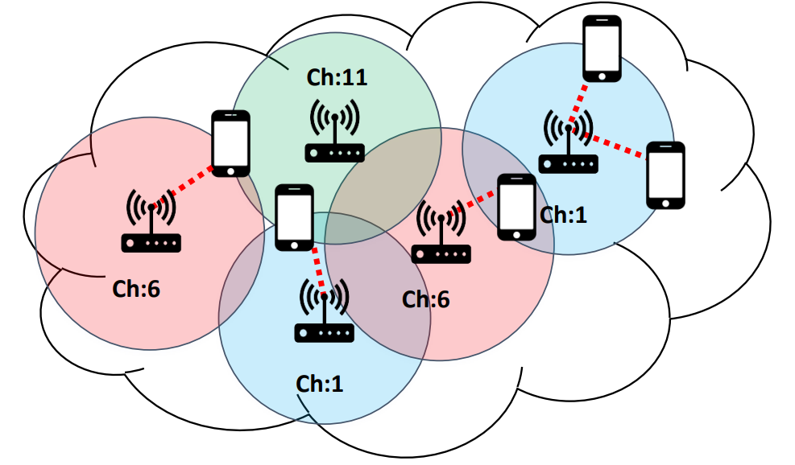
IEEE 802.11 Standard
PHY/MAC specs
Data plane
Management and control
Operation in unlicensed bands
Decentralized spectrum sharing
Coexistence with other technologies
Variety of scenarios
Dense, dynamic, diverse, and uncontrolled
Wireless broadband access
Real-time communication
Uncertainty
(varying channel conditions, channel access contention)
Notes:
Katarzyna
IEEE 802.11 defines…
We all love the advantages of 802.11 technology: free operation in unlicensed bands, ability to coexist with other technologies, and its adaptability to a wide variety of scenarios.
However, there are some disadvantages related to uncertainty: from the wireless nature of the channel to the non-exclusive communication.

Slide 10
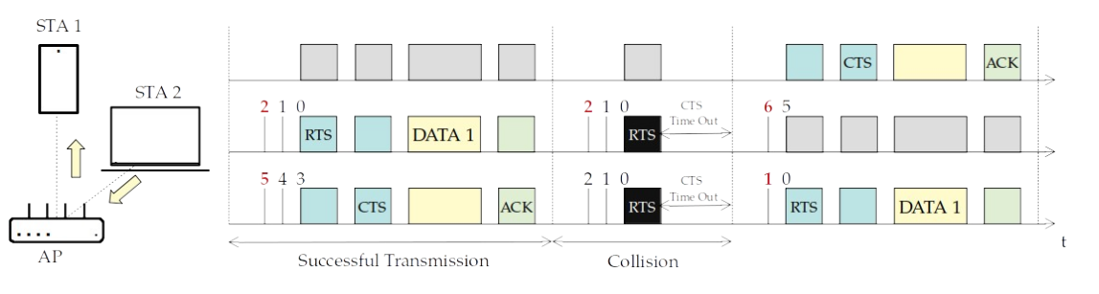
How does Wi-Fi work?
DCF + ARQ
EDCA adds more tx queues
DCF: CSMA + Backoff (CA) + ARQ
EDCA: DCF + Multiple Access Categories for Traffic Differentiation
RTS/CTS mechanism reduces collision time
Notes:
DCF uses a single tx queue and ACKs. EDCA uses defines multiple tx queues for traffic prioritization.
Additionally, four-way handshake can be used to preliminarily reserve the channel and only then transmit. This is to reduce the time of collisions.

Slide 11
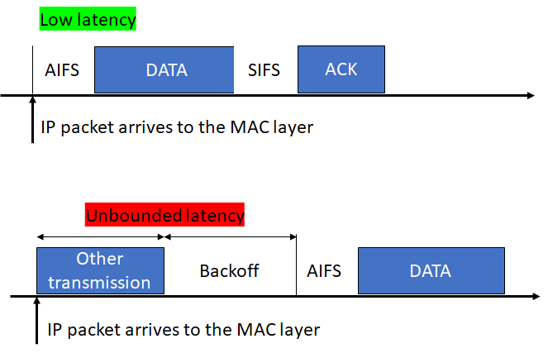
Contention-based Channel Access: Unbounded latency
time
Notes:
Why handling collisions is important?
Time of other transmission is unknown, since there may be collisions or successful transmissions
As a result, the exact time of deferral is unknown

Slide 12


Coexistence with other unlicensed technologies and Wi-Fi networks
Performance of a target Wi-Fi network depends on the activity of other Wi-Fi networks within its coverage, and operating in the same channel
Ch. 1 - Wi-Fi A
TXOP A
TXOP A
Ch. 1 - Wi-Fi B
Channel Busy
TXOP C
TXOP C
time
Ch. 1 - Wi-Fi C
Wi-Fi B may not have access to the channel (starvation): low throughput and high delays!
Notes:
The goal of this slide is to emphasize the coexistence between Wi-Fi networks, and potential starvation problems.

Slide 13
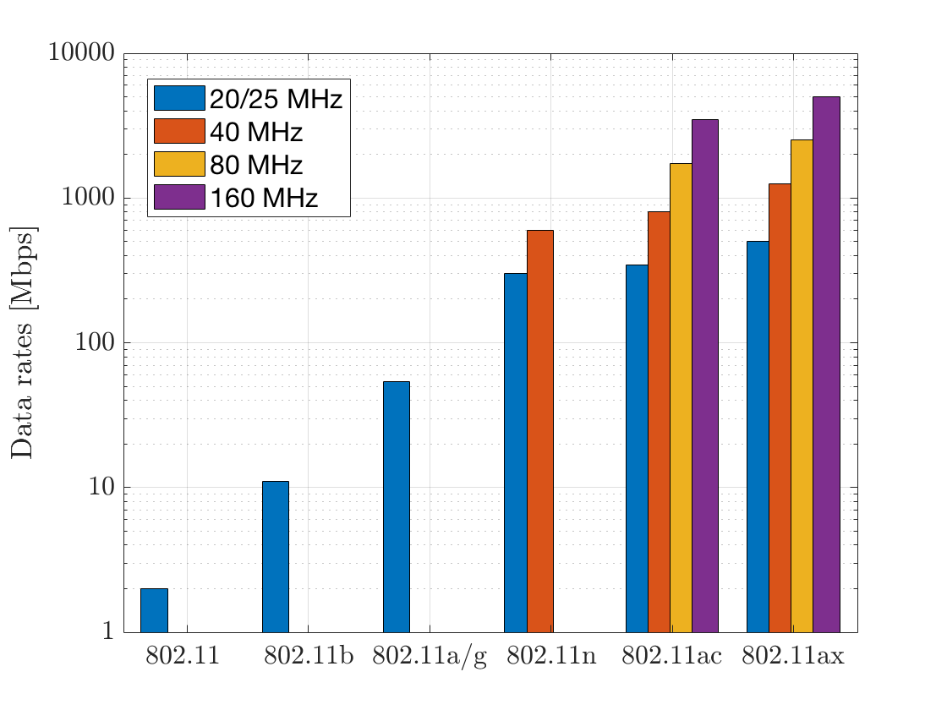
Evolution of Wi-Fi
‘97
‘99
‘99/‘03
‘09
‘13
’19
802.11n (Wi-Fi 4) [2.4 & 5 GHz]
Single-user MIMO
Packet aggregation
802.11ac (Wi-Fi 5) [5 GHz]
Multi-user MIMO (DL)
Channel bonding
802.11ax (Wi-Fi 6) [5 & 6 GHz]
OFDMA
Multi-user MIMO (UL)
802.11be (Wi-Fi 7) [2.4, 5 & 6 GHz]
First products expected late 2023
Multi-link operation
5 Gbps
3.5 Gbps
600 Mbps
54 Mbps
11 Mbps
1 Mbps
4 streams
4 streams
8 streams
Notes:
Let’s have a look now on how Wi-Fi protocols have evolved in the time
We start the Wi-Fi trip in 1997 with the definition of the original standard 802.11. Carrier sense multiple access with collision avoidance (CSMA/CA) was defined in this version of the standard.
IEEE 802.11b in 1999, is an amendment to the initial specification that extends throughput up to 11 Mbit/s using the same 2.4GHz band.
Also in 1999, 802.11a was defined for operating in the 5 GHz band. In 2001, the FCC allowed the use of OFDM in the 2.4 GHz, which lead to the 802.11g amendment.
Spatial multiplexing is the key throughput enhancing technology in 802.11n, up to 4 spatial streams can be multiplexed, but towards a single user only, as there is no multi-user MIMO yet. In addition, the channels also had a larger bandwidth (40 MHz formed by using two contiguous 20 MHz channels).
802.11ac has introduced larger bandwidths (80 and 160 MHz) and channels could be non-contiguous.
In addition, it supports downlink MU-MIMO with up to 4 users.
802.11ax provides an increased average throughput per user in high-density scenarios, such as train stations, airports and stadiums.
The standard is basically mainly finalized and among the main new features we can highlight the enabling of both UL and DL MU-MIMO with up to 8 users.
Where we are now? The current standard under development is 802.11be and it will be the focus of this seminar.

Slide 14
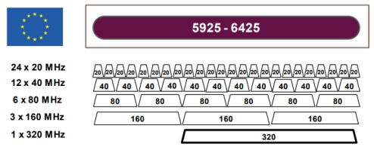
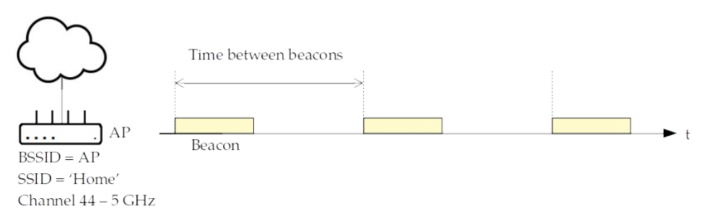
How does Wi-Fi work?
Band & channel selection
AP chooses a channel to operate on
STAs search for an AP and associate to it
AP and STAs exchange their capabilities
802.11 amendment, number of spatial streams, MCSs, ...
Most limiting ones are used
6 GHz band in EU. Source: Wi-Fi Alliance
Notes:
Here is a brief summary on Wi-Fi operation.

Slide 15
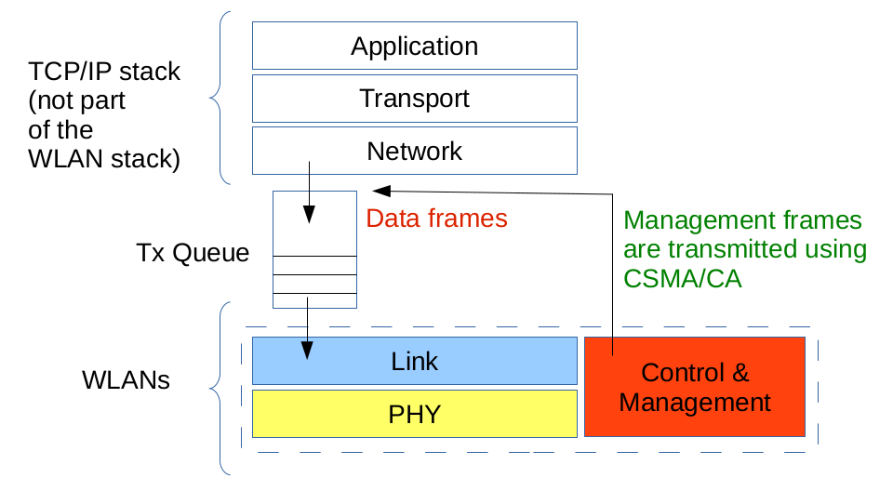
How does Wi-Fi work?
Notes:
As we already noticed, only two lowest layers are specified in the IEEE 802.11 standard.
Both data and management frames use CSMA/CA (i.e., distributed channel access) before they can be transmitted

Slide 16
Degrees of Freedom - Options
Channel selection (AP/controller)
Center frequency and channel width, primary 20 MHz channel
AP selection (STA, AP/controller implicitly control STA association)
Includes band selection and band steering
Any device:
CW parameters (CWmin, CWmax)
Max. number of retransmissions per packet
TXOP duration, max. A-MPDU/A-MSDU size (in bytes / packets)
Tx power, channel state (busy/idle) thresholds: CCA, ED, PD
rate (MCS)
…

Slide 17
Degrees of Freedom - Options
Multi-user transmissions (user scheduling)
OFDMA, MU-MIMO, hybrid
TWT agreements
CSI, BSR, BQR exchange
Wi-Fi 7 — Multi-link operation
Wi-Fi 8 — Multi-AP coordination (coordinated: SR, OFDMA, TDMA, beamforming, joint transmissions etc.)
…
Notes:
Degrees of freedom are constantly increasing
TWT - target wake-up time
buffer status report (BSR)
bandwidth query report (BQR)
SR - spatial reuse

Slide 18
New 802.11 Amendments
Increased Complexity
Band [GHz] | 2.4, 5, 6, …
Channel number | 32, 36, 40, …
Channel width [MHz] | 20, 40, 80, …
Guard interval [ns] | 400, 800, 1600, …
Coding rate | 1/2, 2/3, 3/4, 5/6, …
Modulation | BPSK, QPSK, 16-QAM, 64-QAM, …
Spatial streams | 1, 2, …
Contention window | 15, 31, 63, …
… | …
Plethora of parameters
New mechanisms (e.g., MU transmissions, MLO, MAPC)
Optimal configuration outside of the standard scope
Joint parameter optimization: non-linear!
Requirements of emerging apps and use cases
Uncertainty of wireless channel
Notes:
Katarzyna
We are all aware of the current challenges of 802.11 networks.
First, we have the increasing complexity with a plethora of parameters to play with
Next, we have new requirements from emerging applications…
Finally, there is the inherent uncertainty of the wireless channel…

Slide 19
Wi-Fi Use-cases Have Different Requirements
Broadband Internet access
Teleconference/video streaming, remote work and education
Cloud-supported productivity: fast content/file exchange in collaborative environments
(Cloud) Gaming, VR/AR/Metaverse XR
Industrial applications: system & plant control (machines, robots, IoT)
Requirements
Low-latency, high-throughput, high-reliability
Stable connectivity & predictable performance
Notes:
Katarzyna
An additional challenge is that the use cases for Wi-Fi are going beyond simple Internet access.
Recent years have seen an increase in teleconferences, remote work, and collaborative environments.
Entertainment applications, (Cloud) Gaming, VR/AR / Metaverse, are on the rise.
Also, 802.11 is appearing in industrial deployments.
These use cases have stringent requirements: …
To fulfil these requirements, we can ask performance related questions, which ML may help answer.
For example in case of the extended reality
XR streaming: we can ask ML to adjust the video ‘rate’ to the highest value that does not cause congestion in the network

Slide 20
When AI/ML May Be Useful?
Adaptation to different environments
Find satisfactory configurations of IEEE 802.11 MAC/PHY parameters
Recognize conditions: LOS/NLOS, interferers, coexisting technologies, …
Smart decisions
AP selection, wait/transmit (e.g. in MLO), CW/MCS selection, …
Improve parameter estimation
Beamforming coefficients, overhead reduction, …
…
In ML, “algorithms can learn from training data without being explicitly programmed”
Notes:
It can be helpful when we need to adapt…

Slide 21

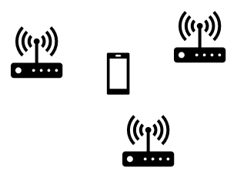
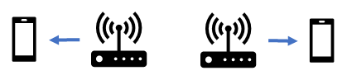
Performance Trade-offs
AP selection (if multiple APs available, on different channels)
RSSI only: Better channel quality, risk to overload a single AP;
Load-based: Low channel quality;
Channel access parameters (CWmin, CWmax)
Low values: fast channel access with low number of contenders (low delay and high throughput), the opposite otherwise; may be problematic in case of hidden nodes;
Spatial Reuse: Increase PD threshold & Decrease Tx. Power
Higher chances to transmit (low delay & high throughput);
Lower MCSs (longer transmissions, lower throughput);
Using wide channels:
Higher rates (high throughput, low delay), but higher contention (the opposite);
backoff
backoff
20 MHz
20 MHz
20 MHz
20 MHz
80 MHz
Notes:
We should be extremely careful when training the ML model. Both not enough data and too much information may produce wrong results.

Slide 22
ML Applications to 802.11 Performance Improvement
802.11 area | ML objective | ML methods | Improvement
Channel access | Select CW value, modify CW update rule | Mostly RL | Higher throughput
Link adaptation | Select transmission rate Predict link-layer throughput | Mostly RL SL | Higher throughput
PHY | Classify signal source, de-noise signals estimate interference | Mostly SL | Higher accuracy
Beamforming | Select beam sector, beamwidth, transmit power, predict channel characteristics | Mostly SL | Higher throughput, reduced exploration time
Multi-user operation | Select users, schedule RUs | SL and RL | Higher throughput
Spatial reuse, channel bonding | Select channel, transmit power, carrier sense threshold | Mostly RL | Higher throughput, lower latency
More details in our survey: https://ieeexplore.ieee.org/document/9786784
Notes:
Katarzyna
Based on our survey, we’ve extracted the following table which briefly describes 802.11 performance areas, ML goals, ML methods used and how the improvement is measured.
For example…
SILOED

Slide 23
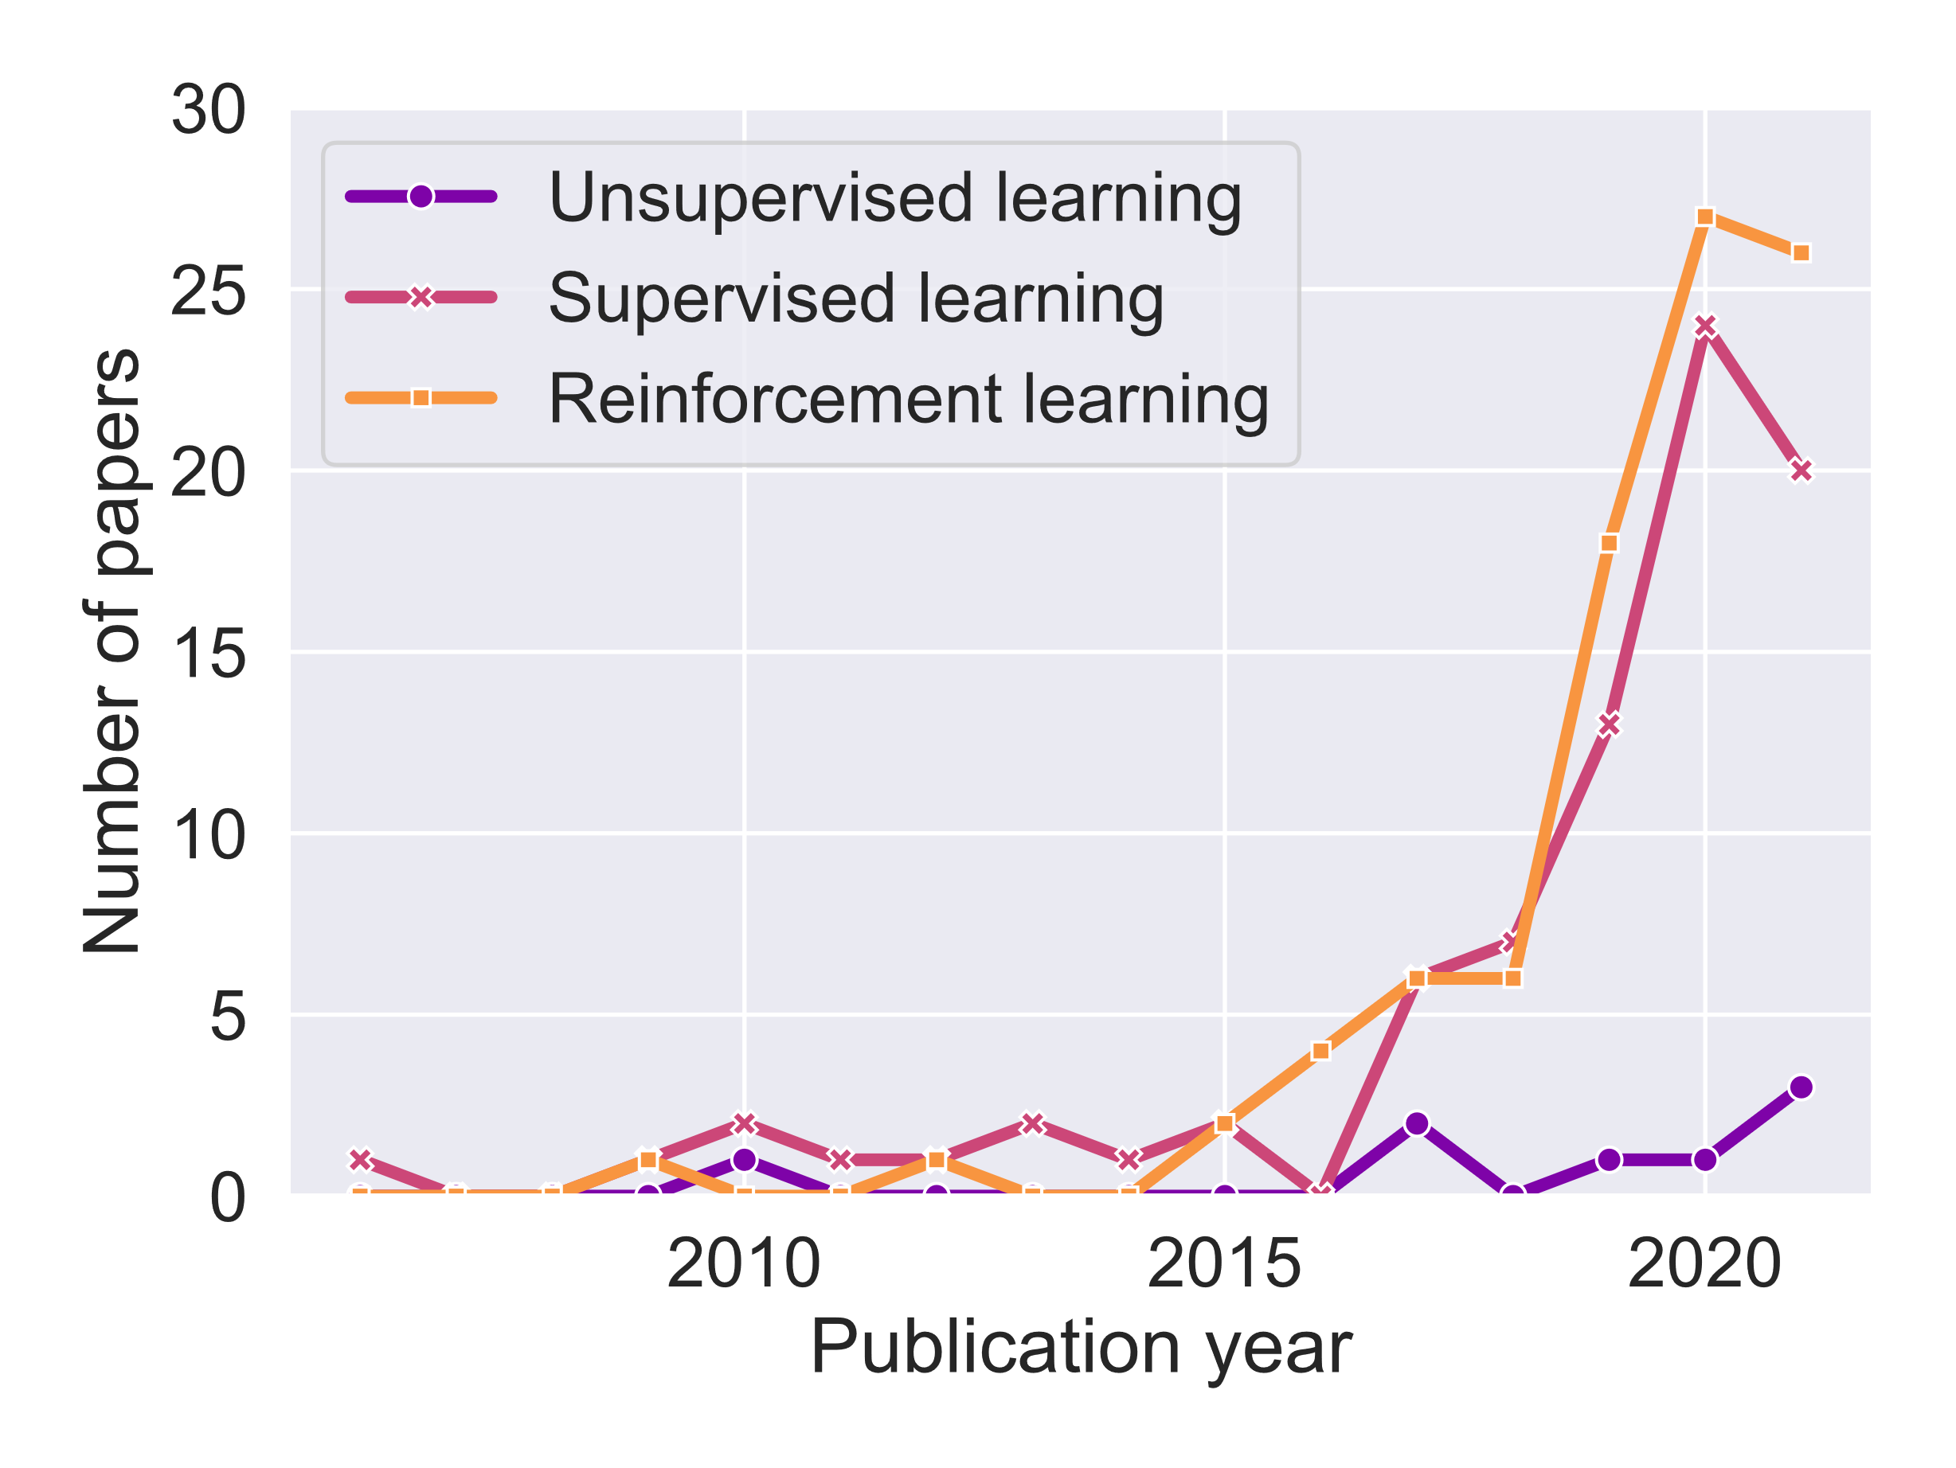
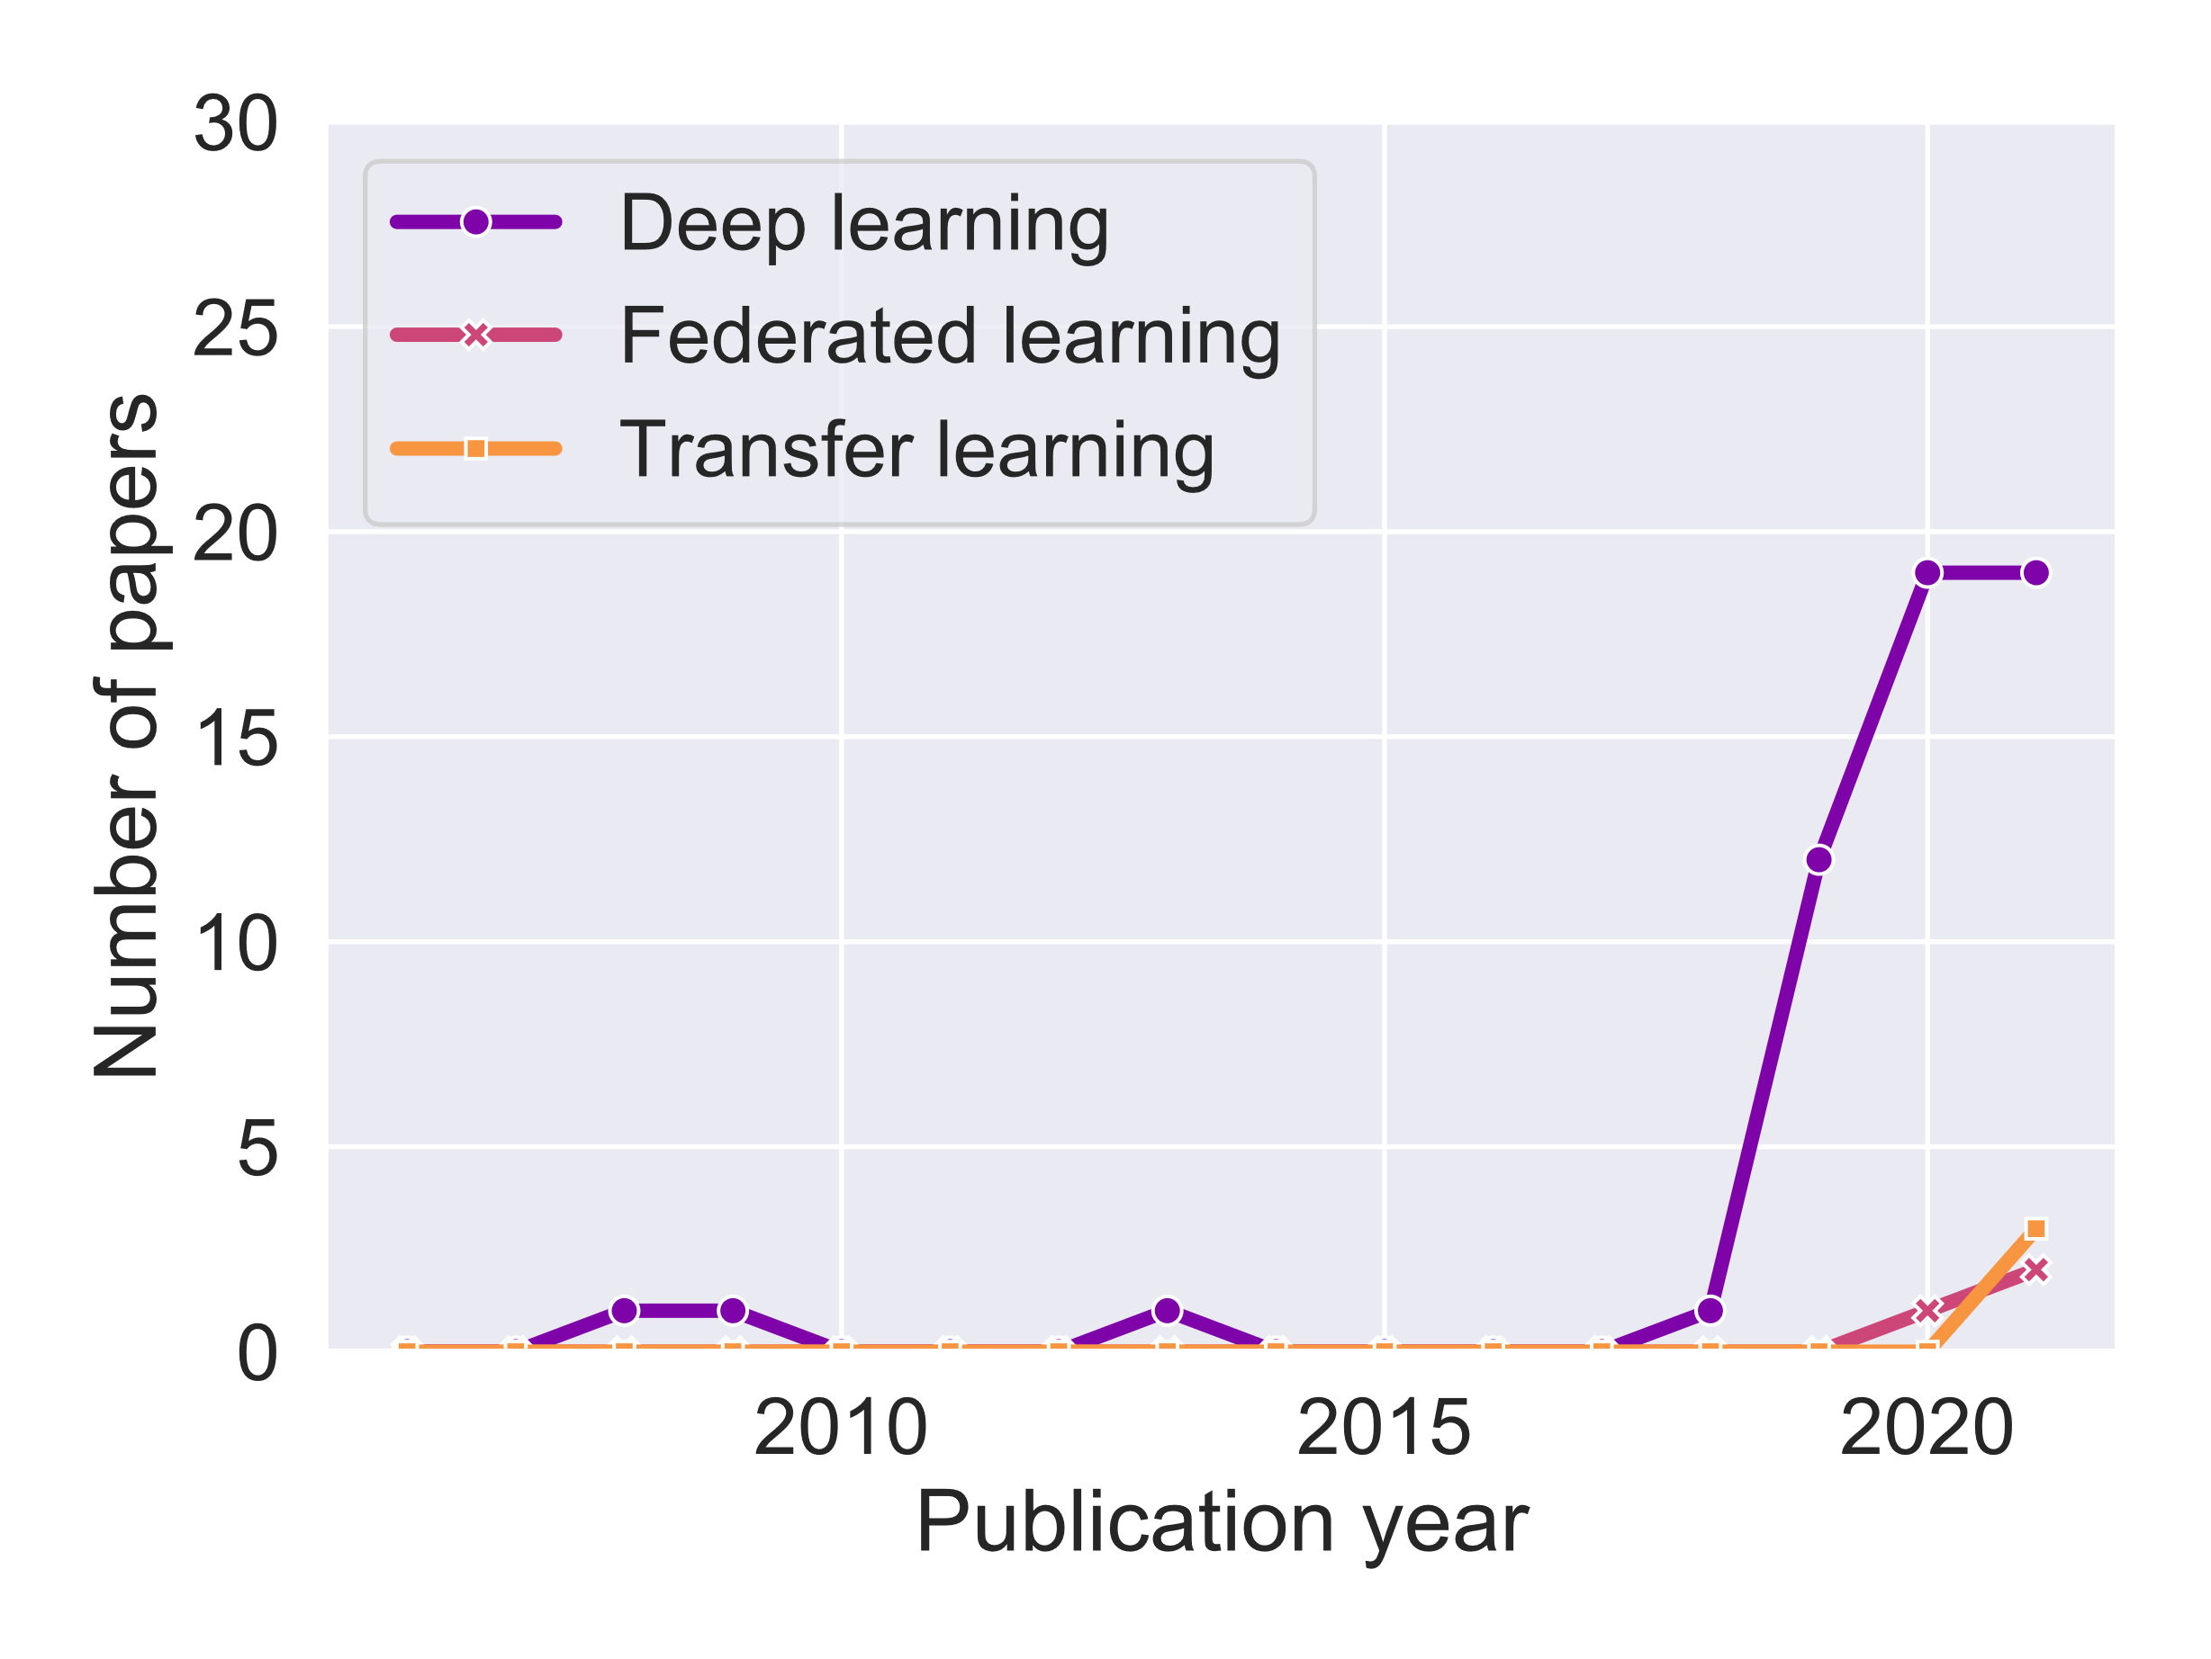
Which ML methods are used?
Notes:
Katarzyna
Before providing more details on SL, UL and RL, let’s check which of them are mostly used in the state of the art related to ML in 802.11
SL and RL are frequently used, while UL is less popular
Popular ML mechanisms: Q-learning, multi-armed bandit, neural networks (ANN, DNN, and CNN). They are usually implemented to optimize a constrained set of 802.11 parameters.
With the increase in available computing power, DL methods are gaining in popularity
Federated learning and transfer learning are a recent introduction in the IEEE 802.11 domain

Slide 24
Wi-Fi augmented with AI/ML
Should we expect that the use of ML techniques will…
improve raw ‘performance’ (i.e., throughput, delay and reliability)?
improve QoE in general (i.e., better AP selection)?
contribute to avoid BSS ‘starvation’ in dense scenarios?
contribute to reduce ‘overheads’ by reducing the amount of exchanged data?
contribute to improve the performance of some functionalities?
Should we achieve any quantitative targets/explicit gains?
Notes:
Katarzyna
The goals of applying ML to improve 802.11 performance can be multiple.
The most common goal that we’ve observed is improving raw performance, i.e., focusing on a single metric.
Other goals could be to…
Researchers aren’t usually focused on achieving any specific targets, just getting closer to optimal performance.
Any initial target? 4x gains? 10%? Only qualitative?

Slide 25
Control System + AI/ML models
To use AI/ML models we often have to also develop a control system (code) able to get the most of them.
This control system uses AI/ML models to improve its decisions
E.g. Tests multiple configurations using a NN model able to predict the Wi-Fi throughput, and choses the one that is best performing.
and is the final responsible of the obtained outcome.
Control System
AI/ML models
Make predictions
Select most likely option
Identify patterns
…

Slide 26
What can be done from the station side?
AP selection
Select an AP able to provide the required performance
Channel access parameters
Fine tune performance, mostly in case of large number of contenders/channel activity
MCS selection
Fast selection of adequate MCS for uplink transmissions
Spatial reuse
Increase channel access rate in dense environments
Channel bonding
Adjust channel widths to surrounding (sensed) conditions

Slide 27
What can be done from the station side?
Multi-link operation
Choose which links and how to use them (reliability, latency, throughput)
Packet aggregation & TXOP duration
Control the duration of each transmission
Power saving mechanisms
Coupled with traffic predictions (when a packet will be ready to be delivered)
Support higher layers
Provide accurate estimations on Wi-Fi performance

Slide 28
Standardization: IEEE 802.11
Artificial Intelligence Machine Learning (AIML) Topic Interest Group (TIG)
AIML Use Cases and Features for WLAN
AIML-based CSI feedback compression
Unsupervised learning allows to reduce CSI feedback
Deep-learning based distributed channel access
Deep learning allows to increase throughput and decrease latency (e.g., CW optimization)
Efficient AIML model sharing/distribution
Efficient model sharing needs to be defined
AIML Enhanced Roaming
AIML can improve roaming decisions
AIML based Multi-AP Transmission
AIML can help in finding AP-STA pairs for multi-AP transmissions, etc.
All AIML TIG documents available @ https://mentor.ieee.org/802.11/documents?is_dcn=aiml
Notes:
Currently there is a discussion about studying AIML as part of future 802.11 amendments
If stations are assumed to be nearby (e.g., stadium scenario), the nearby STA’s CSI has similar path loss/channel. anges: https://www.oreilly.com/library/view/80211ac-a-survival/9781449357702/ch04.html

Slide 29
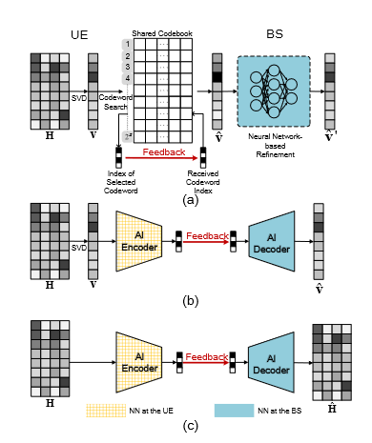
Standardization: IEEE 802.11
AIML-based CSI Feedback Compression
Problem
In 802.11ax/be the AP uses a sounding sequence for beamformee/beamformer communication
Sounding feedback airtime overhead increases with new features (e.g., MAP + many spatial streams)
Benefit from ML
CSI compression
Faster operation
Improved throughput
Guo, Jiajia, et al. "AI for CSI feedback enhancement in 5G-advanced." IEEE Wireless Communications (2022).
Notes:
https://arxiv.org/pdf/2206.15132.pdf
Once the BS is installed, the environment around the BS remains stable for a long time. Given that wireless channels greatly depend on the propagation environment, the channel shows certain characteristics that can be regarded as environmental knowledge. AI is a good tool that extracts and utilizes environmental knowledge to help CSI feedback via end-to-end learning.
Specifically, the UE first performs singular value decomposition on the downlink CSI (H) to produce the eigenvectors, that is, the precoding matrix (V). The UE searches the nearest codeword in a predefined codebook, which is shared by the UE and the BS. The UE feedbacks the precoding matrix V with the codeword shared by the BS. Upon receiving the index of the selected precoding codeword, the precoding matrix indicator (PMI), the BS selects the corresponding codeword through the shared codebook. Then, the pretrained NN refines the obtained codeword.The accuracy of the refined precoding matrix is improved with the help of environmental knowledge. The training and inference operations of NNs are conducted at the BS without the participation of the UE. In the training phase, the input and output of the NN are the selected channel codeword (ˆv) and the perfect precoding matrix (v), respectively. In addition, the NN module can be also added at the UE to increase the speed of finding the codewords.
Inspired by autoencoder-based image compression, an NN-based encoder is adopted at the UE to compress and quantize the generated precoding matrix (v). We can regard the generated bitstream in this framework as the PMI in the existing codebook-based feedback strategy. After obtaining the feedback bitstream, the NN-based decoder reconstructs the original precoding matrix.
In contrast with the above-mentioned frameworks, this third framework feedbacks the entire downlink CSI (H) to the BS via an NN-based encoder. Then, the decoder at the BS reconstructs the original CSI on the basis of the received bitstream. Given that all information of the downlink CSI is fed back, the feedback overhead of this framework is larger than that of the second framework. This framework is the most widely studied in academia.
https://www.cablefree.net/wirelesstechnology/802-11ac/

Slide 30
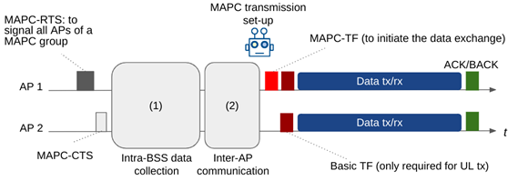
Standardization: IEEE 802.11
AIML-based Multi-AP Coordination
Problem
Dense multi-AP networks suffer from co-channel interference, multi-AP coordination (MAPC) becomes necessary
Benefit from ML
Selection of non-colliding groups → improved utilization of radio resources
Notes:
Figure 2 presents an example message exchange for an AIML-enhanced multi-AP coordinated transmission. (This is an illustrative example only, the exact exchange of MAPC messages will be determined by UHR.) The MAPC exchange is triggered by a sharing AP (AP 1) with an MAPC-RTS/MAPC-CTS exchange between all APs involved in the upcoming coordinated transmission.
Then, in an initial phase —indicated by (1) in Figure 2— each AP collects information from its associated stations. Note that this data collection and report phase may not be required if AIML can predict measurement reports, or in the case that some measurements are quasi-static. Moreover, principal component analysis (PCA) can be used to reduce the amount of data to exchange (i.e., exchanging only a fraction of the total data, and reconstructing the missing data at the destination). However, since the reconstructed data may incur information loss, the accuracy-overhead trade-off needs to be considered.
In the second phase —indicated by (2) in Figure 2— these reports are communicated to the sharing AP which uses AIML to select and configure the MAPC transmission strategy to be used in the final phase of transmission. It is expected that the pre-trained AIML model provides either a near-instantaneous response for immediately scheduling the coordinated transmission or schedules coordinated transmissions in the near future.

Slide 31
Outline
Part 1: Introduction. Why Wi-Fi may want to adopt AI/ML? (30 mins) - Katarzyna
Wi-Fi overview: A 30-year path from IEEE 802.11b to IEEE 802.11be, and beyond.
Open challenges in Wi-Fi: Dealing with complexity and uncertainty.
Requirements of next-gen WiFi networks.
Part 2: A primer on AI/ML (45 min) - Szymon & Boris
Concepts, definitions, and overview of the main ML types (supervised, unsupervised, and reinforcement learning), including Wi-Fi examples.
Popular ML techniques and paradigms: deep learning, reinforcement learning, online learning, federated learning.
Deployment options: architecture, data handling, marketplaces.
Break (10:00-10:30)
Part 3: Multi-Armed Bandits for Responsive Wi-Fi networks (45 mins) - Boris & Szymon
Multi-Armed Bandits: exploitation-exploration trade-off; e-greedy, Thompson Sampling, UCB.
Examples: Channel Selection; AP selection;
Reinforced-lib + Example (MCS selection).
Part 4: Wi-Fi & ML: Practical considerations (45 mins) - Francesc
Wi-Fi & ML: A two-sided relationship
Adoption of ML in Wi-Fi
Wi-Fi in the ITU-T AI/ML in 5G Challenge: Use cases, tools, and results from the 2020-2022 editions
Hands-on Exercise II: Predicting the performance of Wi-Fi through Deep Learning
Part 5: Open challenges, future research directions, and summary (15 mins) - Katarzyna
Open challenges and future research directions; Synergies with other disruptive technologies.
Current AI/ML trends: LLM and Generative AI.
Summary and takeaways.
Notes:
Szymon
Once we have overview the main ML techniques, let’s move to another important concept: model training and deployment

Slide 32
2 A Primer on AI/ML
Notes:
In this part, we will focus on how ML techniques can help us build models from data. All the content here is introductory, but we think it solves a fundamental question: how ML techniques could be used to improve Wi-Fi performance.

Slide 33

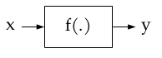
Artificial Intelligence and Machine Learning
Artificial Intelligence: collect/sense (get the data), reason (interpret the data), act (based on how the data is interpreted), enjoy (or not) the result, and self-correct / adapt.
AI uses ML techniques to extract “knowledge” (learn) from the data
Data + ML Algorithms + Reasoning + Actions→ (A)Intelligence
Machine Learning: Set of algorithms / techniques / mechanisms that are able to learn from data.
Learn: map output to inputs, i.e., build the function f(.) that represents the ‘knowledge’
General mechanisms, not explicitly programmed for a single family of functions f(.); In some cases, their performance/learning bounds are known
Deep Learning: Includes learning the relevant ‘features’ of the model.
Intelligent agent:
body + policy (brain)
AI
ML
DL
Notes:
Generally, there is some confusion between AI and ML concepts.
By AI, we refer to the complete cognitive cycle that includes collecting data (sensing), interpreting it (analysis), to act accordingly (acting), and to be able to rate the obtained result (assessment).
Then, in such a cognitive cycle, ML techniques are responsible to extract the ‘knowledge’ from the data, or in other words, to learn.
What is learning? Understanding the relationship between a set of inputs and a given output. If given some inputs we can predict the output, it is because we know what will happen, so we have that knowledge.
An interesting aspect of ML techniques is that they are relatively general, and so they are useful to learn multiple types of functions.
Also, an interesting property of these algorithms is that their ‘bounds’ are known, i.e., how much time the will need to find/learn the best solution.
Deep learning is currently a hot topic. In many cases it is introduced as something else than ML, which is not correct. In ‘standard’ ML the inputs, called features, are in general provided. However, in many problems, to select which are the features to use is indeed the big problem. Deep learning solves that by implicitly choosing which are the good features to use.

Slide 34

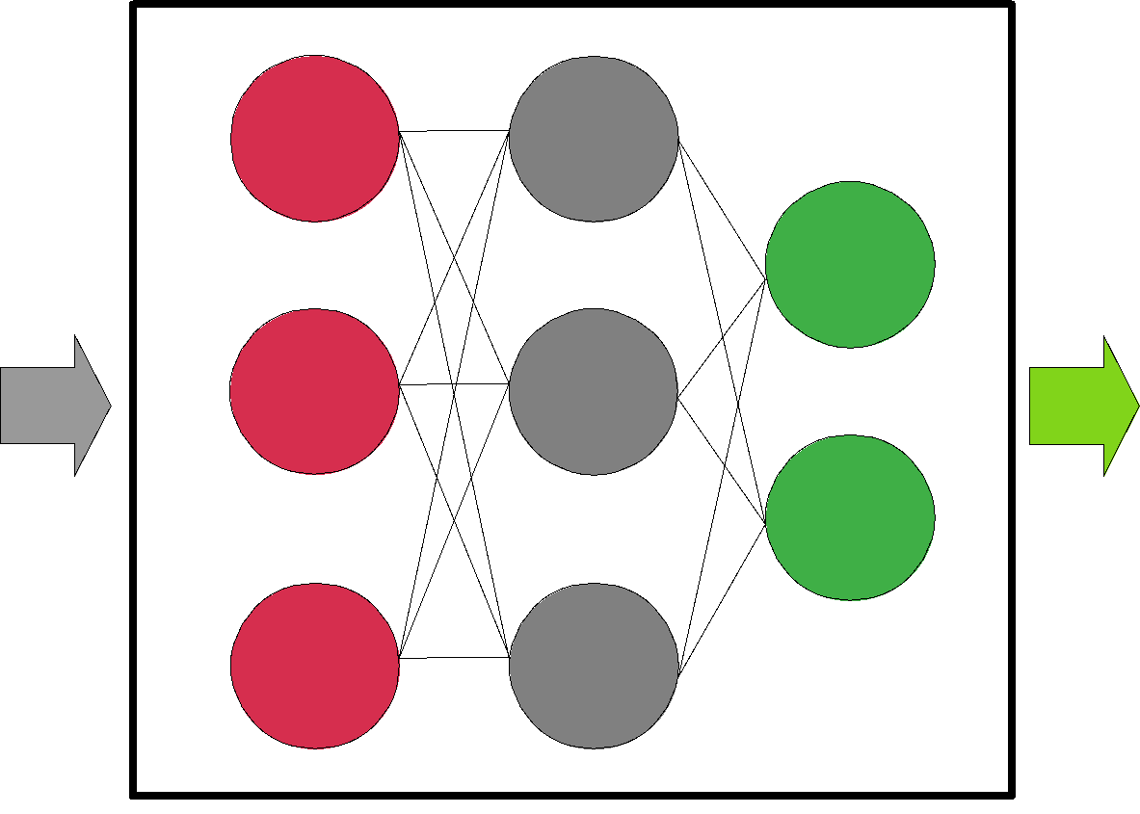
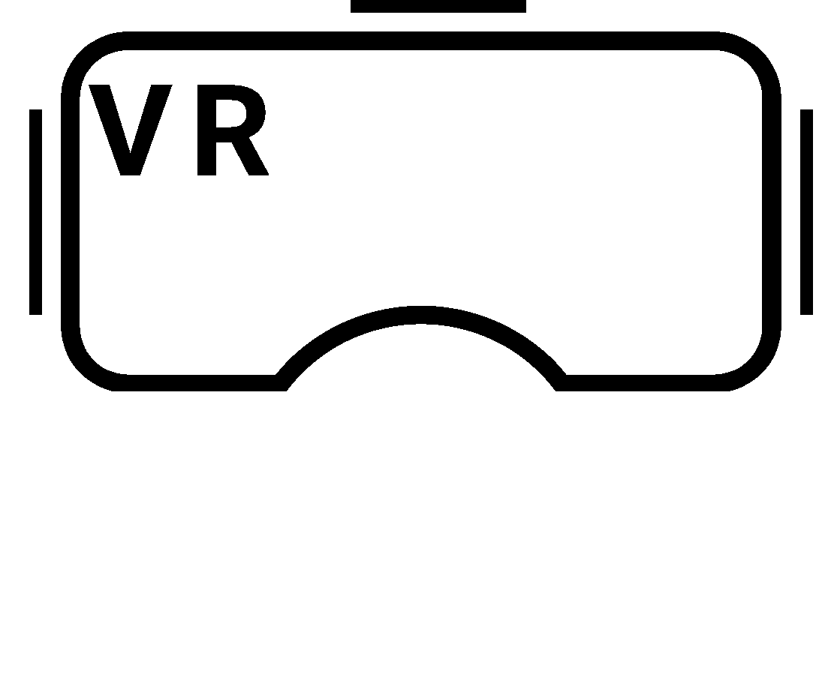
Building models
The ML model is f(.), it describes a system.
ML enables to model extremely complex systems by characterizing the hidden relationships between input parameters x (features) and outputs y (labels).
ML vs analytical models: ML models use ‘real data’
Example: To train a model able to suggest the best MCS to exchange data between the AP and laptop.
Features
- RSSI
- Throughput
- PER
- Coll. prob.
- SS
- Bandwidth
MCS?
MCS
Model
Notes:
Summarizing, ML techniques enable to build complex models from data by learning that function that maps input parameters (features) to outputs (labels).
For example, we can have a model that given some measurements and targets, tells us the best MCS to use.

Slide 35
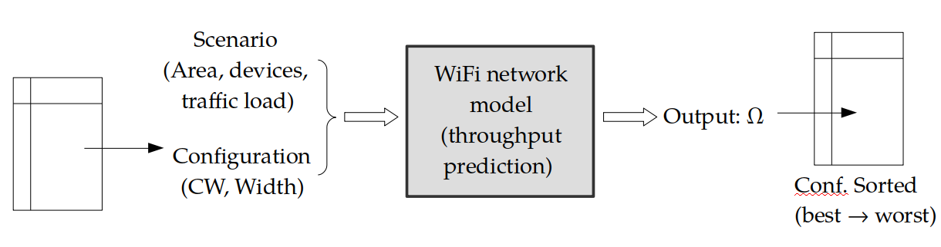
Why is having a model useful?
A model can give us some useful information before taking (better) decisions.
It can predict what will be the ‘performance’ (output) given a certain configuration (input).
Example 1: Given a certain scenario, we want to find the configuration that maximizes the throughput
Notes:
Great, we have a model! Then, the natural question is: what can we do with a model?
In general a model could be used for prediction (think of weather forecast models). Predicting what will happen given a certain ‘configuration’ can help us decide if that is good or not, or by iteratively applying that model, find the best one.

Slide 36
Why is having a model useful?
A model can give us some useful information before taking (better) decisions.
It can predict what will be the ‘performance’ (output) given a certain configuration (input).
Example 2: After gathering data from different APs (load, number of associated clients, technology & capabilities, RSSI, etc.) a STA can sequentially predict the best AP to associate.
A
B
good RSSI, 11ax, 80% busy
medium RSSI, 11n, 10% busy
?
B
Notes:
Another example is to have a model that based on some data gathered from different APs (that can be present in their beacons) predicts which is the best AP to associate.

Slide 37
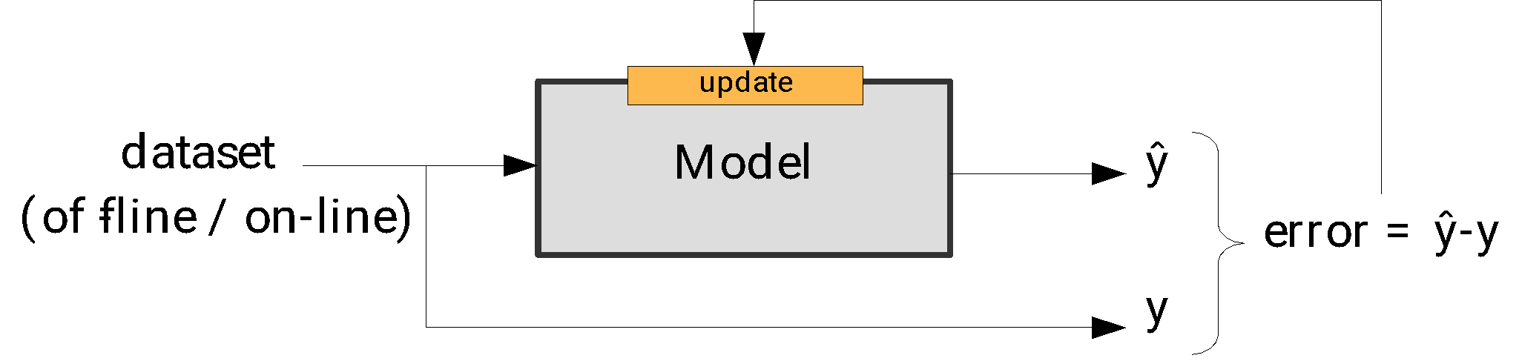
ML techniques build models from data (training)
Two training cases:
Off-line: using a static dataset (present from the beginning).
On-line: the dataset is created in real-time, so the model is updated as more data is collected.
Training is based on minimizing the error between what is known (in the dataset) and predicted (by the model) outputs.
Models should be as general as possible: the aim is not to exactly map inputs and outputs, but to learn the context behind any existing relationship (no overfitting).
A model can be first trained off-line, deployed and then improved with on-line training
Notes:
Re-cap: we know that models can be useful, and we know that they can be built from data using ML techniques.
In general, by building the model, since they are based on general ‘functions’ we will refer to training them.
We can train ML models off-line (the dataset contains all data) and on-line (the data-set is created in real-time).
This ‘training’ is basically done by iteratively minimizing the error between a prediction and the real value.
And here, it comes a first important concept: we have to trade-off the accuracy of a model vs its applicability in different situations, which can be solved by considering a large and heterogeneous and diverse training dataset.
Tips to solve overfitting: https://towardsdatascience.com/8-simple-techniques-to-prevent-overfitting-4d443da2ef7d

Slide 38
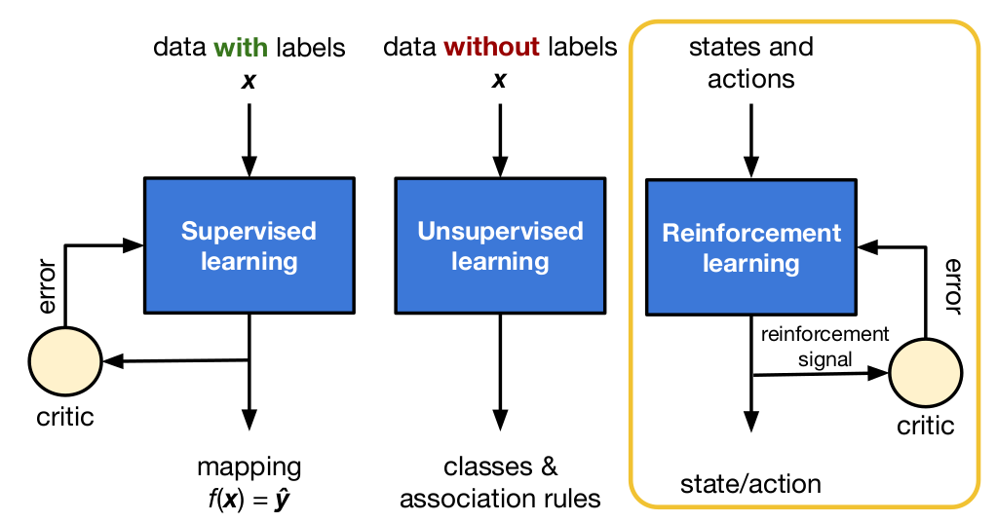
Taxonomy of ML models
Supervised Learning (SL)
Unsupervised Learning (UL)
Reinforcement Learning (RL)
How are these models trained?
Centralized; Decentralized / Distributed
Single player; Multiple players
Ex: Distributed Federated Learning
Notes:
There are three big families of ML models based on the purpose of those models [Don’t waste time here explaining them]
Supervised Learning models: we have a data set with all features and outputs (labels), so we simply focus on learning the f(.) that maps inputs and outputs
Unsupervised Learning models: in this case we don’t have the outputs, so we can only target the properties of the input parameters. For instance, we can rate how similar are two input feature vectors.
Reinforcement Learning models: the available data is the information about how we interact with the environment, for instance, the system configuration. The aim is to learn which are the best actions to minimize the error, or alternatively, maximize the reward we obtain.
All three types of models can be trained in a central device with all data, or using decentralized / distributed approaches. There could be also a single player (the centralized case, and multiple players. We will focus on this later on.

Slide 39
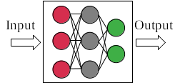
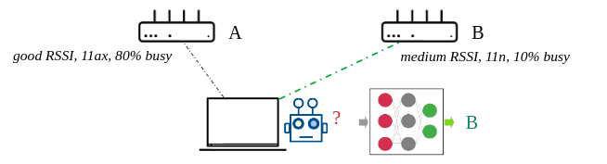
Supervised Learning
Goal: Training data includes x and y, so the goal is to learn f(.)
Dataset: We need a consolidated dataset to train the model, retraining as the dataset updates
Techniques: Time series analysis, regressions, vector machines, decision trees, neural networks, etc.
Main uses: Prediction (output is a real value), classification (output is a label, e.g., 0 or 1)
Wi-Fi example: AP selection
The STA uses a trained model that predicts which is the best AP to associate. The input of the model should consist of the info gathered by the STA for each AP.
Notes:
So, let’s start with SL. As we have said before, the goal is to learn f(.) from training data that contains the input (features) and output (labels).
Therefore, we need a consolidated dataset, with a size proportional to the number of inputs and range of outputs.
There are multiple techniques in SL, from simple regressions to neural networks.
As said before, main uses are for prediction or classification, which is more or less the same. For example, the case introduced before, regarding AP association.

Slide 40

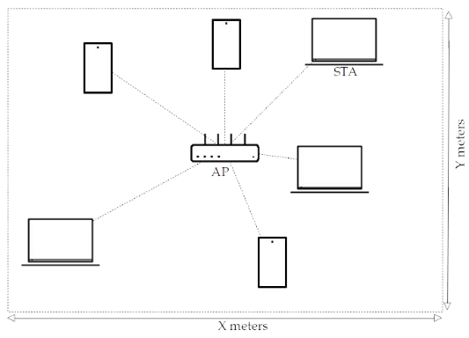
Performance Prediction with Linear Regression
10k simulations → train model → validate model
Working example in Google Colab
https://colab.research.google.com/drive/1YR26yWUKwNVH1D5kVWF-0EMB35Ci0ppL?usp=sharing
Notes:
Let’s show you another example. In this case, we have a single BSS that consists of one AP and several STAs deployed over a certain area.
Running multiple scenarios, where the DL and UL load changes, the size of the area, the CW used, the channel width, etc. we obtain different packet error prob, throughput, packet delay, etc.
So, the question now is if we can create a model able to predict the outputs given a new scenario, without running the simulation.

Slide 41
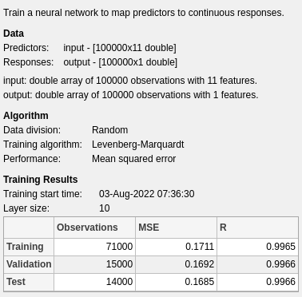
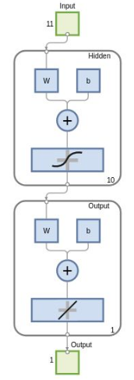
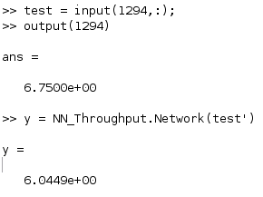
Example: Neural Network
Predicted Throughput
CW_{min}
Output layer
Real Value (Mbps)
Hidden layer
Matlab NN representation
Input layer
Prediction (Mbps)
Notes:
An alternative is to use a Neural Network, where we can plug all input parameters, and get the throughput prediction. In this case, it is a simple NN with a single hidden layer, and 10 neurons.
As we can see, given an input of CWmin as 1294, the response is reasonably accurate.

Slide 42
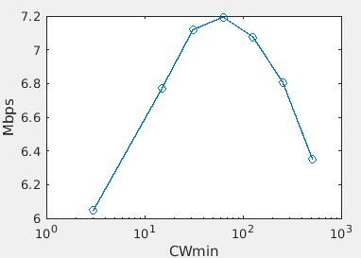
Example: Neural Network
We can use the NN model to try different CW_{min} values to see which is the best performing one.
Predicted Throughput
CW_{min}
Output layer
Hidden layer
Matlab NN representation
Input layer
configuration to test
Notes:
Since now we have a model able to predict the throughput, for a given scenario we can update the CW value, and see what is the the optimal value.

Slide 43
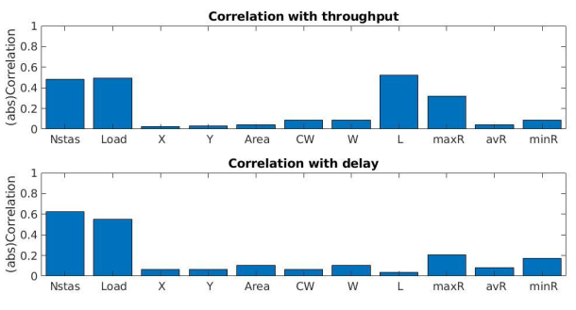
How to define the feature set?
We can study the cross-correlation between the desired output and the input features from the dataset, discarding those that show a low value.
…or rely on deep learning solutions to choose the most appropriate ones.

Slide 44
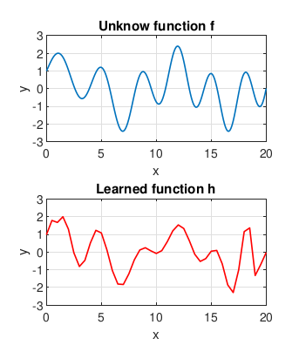
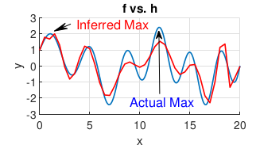
A problem (or not) of SL models
They provide accurate function approximation in general by minimizing the difference (i.e., mean squared error), but may fail to capture maximum / minimum values.
Not always useful for ‘optimization’ purposes.
Notes:
Boris
Let’s skip this slide in this talk, but keep it for the future

Slide 45
Directly predicting the ‘good’ configuration
state
f(x)
optimal conf
Dataset to train a ‘black box’:
What ‘configuration’ do we plug in the dataset? The one giving the highest ‘performance’ for the same observed parameters?
How do we find it? For each set of ‘input parameters’, should we check multiple configurations to find the good one?
It is hard to get this kind of dataset in practice.
input: observed parameters (including KPIs)
output: configuration
 |  |  |  |  |  | …

Slide 46
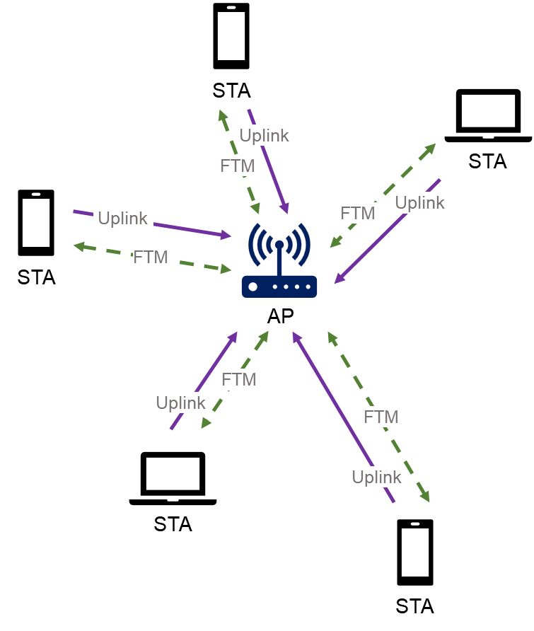
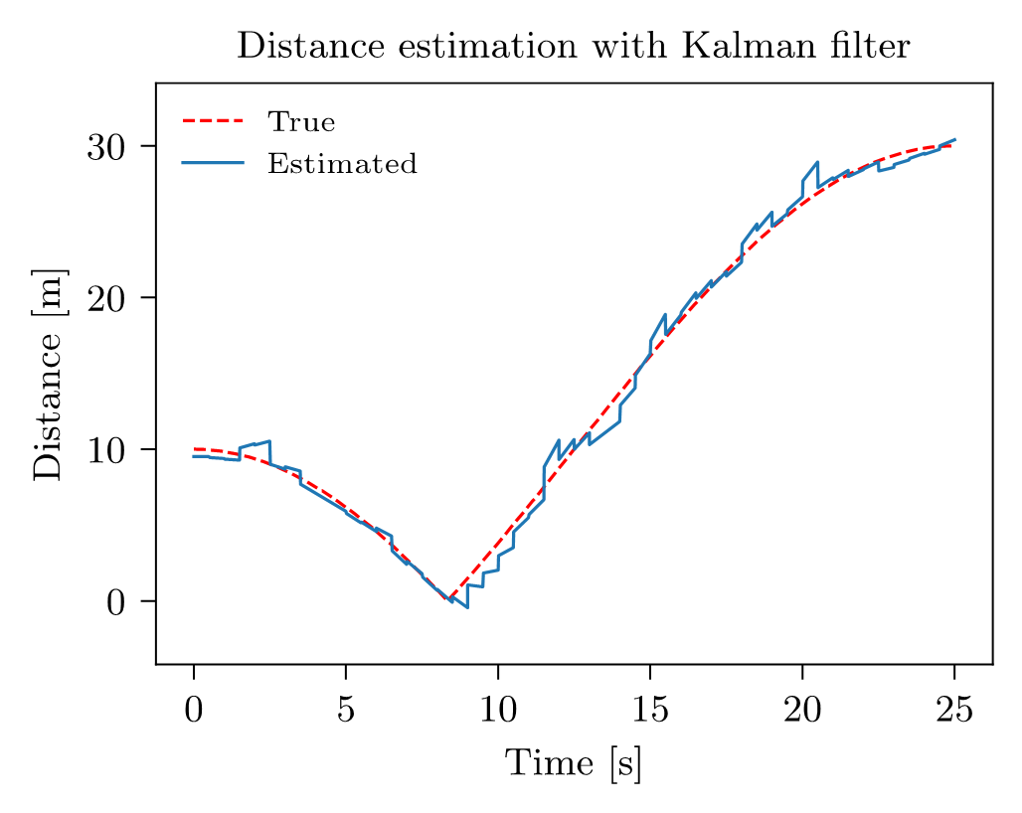
FTMRate
https://github.com/ml4wifi-devs/ftmrate
W. Ciezobka, M. Wojnar, K. Kosek-Szott, S. Szott, and K. Rusek. "FTMRate: Collision-Immune Distance-based Data Rate Selection for IEEE 802.11 Networks." 24th IEEE International Symposium on a World of Wireless, Mobile and Multimedia Networks (WoWMoM), 2023.
Notes:
Modern machine learning had tremendous successes in various tasks but it is not always the best tool for the job.
There are use cases where classical statistical methods are still preferred due to their simplicity, efficiency and explainability.
Examples of such could be classic filters such as the Kalman filter.
The recent development of automatic differentiation in ML libraries allows the integration of classical methods and parts of larger ML solutions or the use of ML blocks inside the classic algorithm (trainable particle filters, neural networks layers solving the optimization problem etc.).
In our solution, FTMRate combines parts of supervised learning for channel model, stochastic differential equations and Kalman filter in as a single solution that is accurate yet lightweight enough for an embedded device.

Slide 47
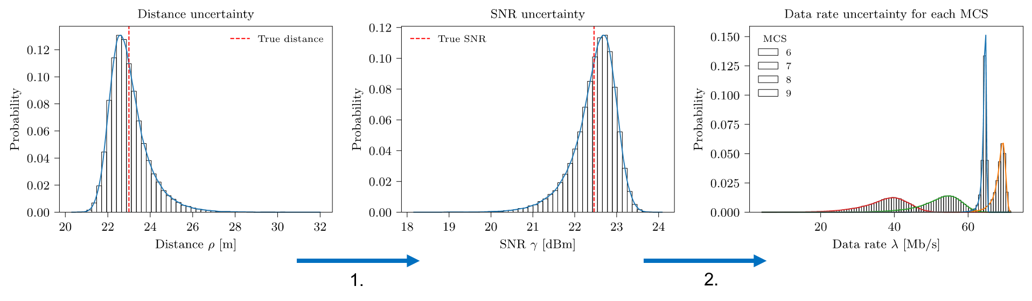
FTMRate
https://github.com/ml4wifi-devs/ftmrate
W. Ciezobka, M. Wojnar, K. Kosek-Szott, S. Szott, and K. Rusek. "FTMRate: Collision-Immune Distance-based Data Rate Selection for IEEE 802.11 Networks." 24th IEEE International Symposium on a World of Wireless, Mobile and Multimedia Networks (WoWMoM), 2023.
Notes:
MCS inference is made in two steps:
1.Given distance distribution -> SNR distribution (with channel model)
2.Having SNR distribution -> expected data rate for each MCS (multiply theoretical data rate by success probability distribution given SNR)

Slide 48
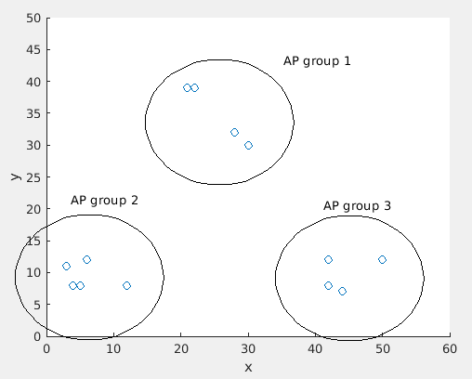
Unsupervised Learning
Goal: Find patterns/trends/similarities in a dataset when only the features are available
Dataset: We need a consolidated dataset to train the model, retraining it as the dataset updates
Techniques: K-means, Self-Organizing Maps (SOMs), hidden Markov model (HMM), Auto encoders (AEs), Principal Component Analysis (PCA), Restricted Boltzmann machine (RBM), fuzzy C-means, etc.
Main uses: Cluster the data in similar groups
Wi-Fi example
AP selection from a dataset that contains only the features. Then, identifying which APs are similar may reduce the ‘testing’ phase by only requesting association to an AP of each representative ‘cluster’.
Notes:
A second family of ML techniques are called unsupervised learning. The goal now is to find patterns or similarities in a dataset when only the features are available.
The main use is to cluster data in similar groups. Given a dataset, determine how many groups can be created with the data input, and associate some ‘differentiating’ properties to each group.
A possible example, following the AP association example, is to gather data from multiple APs in sight, and group them to find similar APs. In this case, if we want to check different APs, we can do that only selecting one ‘example’ from each group, as all from the same group should offer a similar performance.

Slide 49
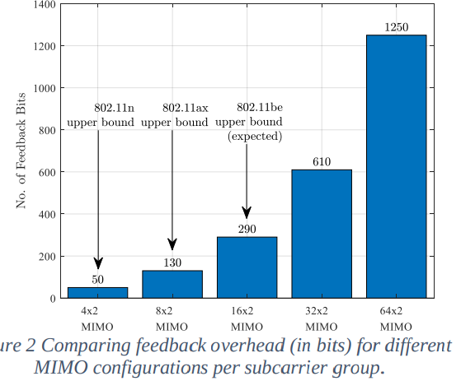
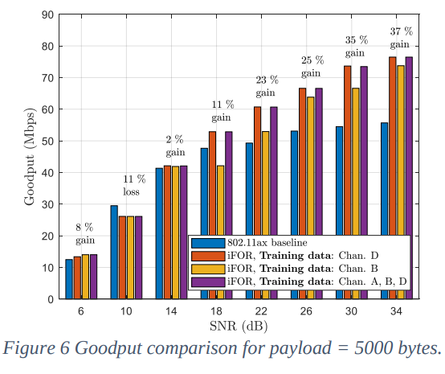
Unsupervised Learning: CSI overhead reduction
Source: Deshmukh, Mrugen, Mahmoud Kamel, Zinan Lin, Rui Yang, Hanqing Lou, and Ismail Güvenç. "Intelligent Feedback Overhead Reduction (iFOR) in Wi-Fi 7 and Beyond." In 2022 IEEE 95th Vehicular Technology Conference (VTC2022-Spring), pp. 1-5. IEEE, 2022.
“Instead of feeding back the angles to represent one CSI vector, we propose the iFOR algorithm, which feeds back an index from a set of candidates that represent a diverse set of CSI feedback”
Clustering N vectors in M (e.g., 1024, 10 bits): K-means.
The M vectors are known at the AP and the stations.
A station measures the CSI, and selects the candidate vector with a lower euclidian distance to the measured.
Only the index (10 bits) is exchanged.
Notes:
This is indeed the first use-case of the AI/ML TIG

Slide 50
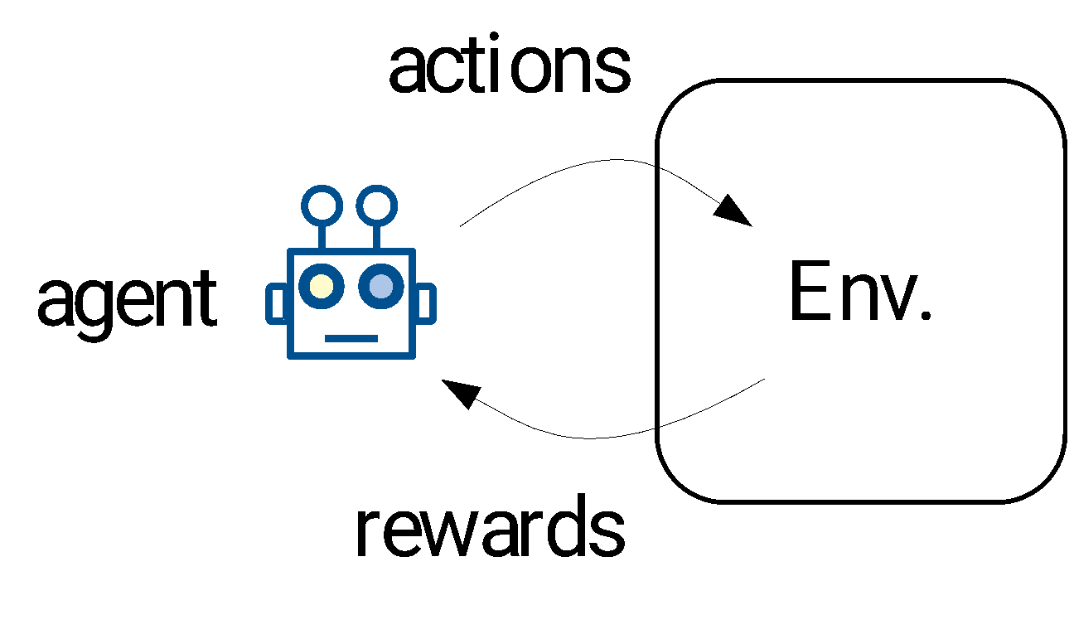
Reinforcement Learning
Goal: Learn from experience (relationship between actions and rewards)
Dataset: sequence of actions and rewards obtained
Techniques: Multi-armed Bandits, Q-learning, DQL
Main uses: Adaptive systems in dynamic environments
Wi-Fi examples: exploration – exploitation tradeoff
AP selection by trying and rating different APs
Dynamic channel selection: given a set of unknown channels, we need to find the best one (the empty one)
Dynamic configuration of Tx Power and CCA to support Spatial Reuse
etc.
Notes:
The last family of ML techniques may look quite different from supervised and unsupervised.
The idea here is to learn in a real-time way, and from the experience gathered by the agent. At the beginning there is no data-set. Also, instead of features and labels, we have actions, states and rewards.
The goal is to maximize the reward, in the short, long term, or both.
In terms of techniques, we have MABs, Q-learning, and Deep Q-learning. We will see them in more detail later.
Regarding its use, well, basically to adapt to a particular environment by finding the best configuration there.
Some examples present in the literature are AP selection, channel selection, tx power and CCA configuration, etc. In all of them, the agent starts without any information about the environment, and builds it by interacting with the environment.

Slide 51
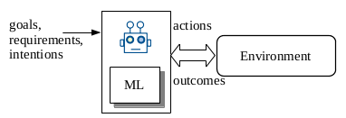
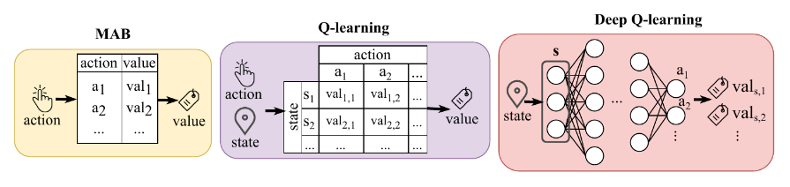
Reinforcement Learning
An ‘agent’ learns by interacting with the ‘environment’
The agent can play different ‘actions’
For each action, the agent receives a ‘reward’
If possible, the agent may characterize the environment through a set of ‘states’
The ML algorithm tells the agent how to select the actions to maximize the reward
Notes:
In RL we have an agent that interacts with the env.
An important thing to keep in mind: the ML algorithms is who tells the agent how to interact with the environment.

Slide 52
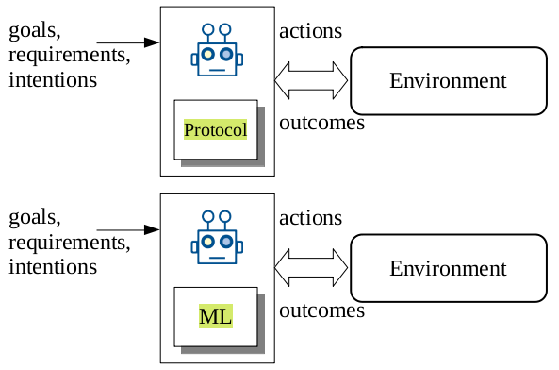
RL vs standard ‘rule-based’ protocols?
RL naturally adapts to different situations.
but…
… requires time to learn.
… higher computational resources.
The two approaches can be also combined.
Example: We can learn the protocol.
A
B
C
D
A
B
C
D
Pre-programmed
Learned
Notes:
Before explaining in more detail the different RL techniques, it would be natural if we wonder why an ML algorithm and not just a protocol to interact with the environment.
Both options have pros and cons. The protocol is efficient, but it only acts as it has been programed. The RL agent is ‘smart enough’ to try to learn the best strategy to maximize the reward. Of course, the prize to pay is time to learn, and higher computation complexity.
In the following example, our protocol can decide that if we are in state B and something happens, we must move to C or to A. Using RL, the agent may learn that in state B, either you stay, or move to D.

Slide 53
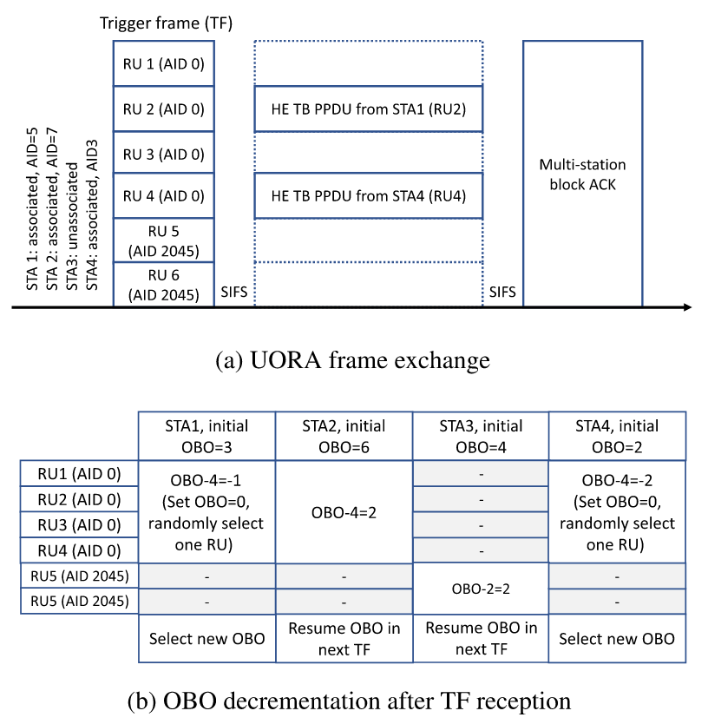
RL vs standard ‘rule-based’ protocols? 802.11ax Example: UORA
OBO decrementation
Standard: fixed
Efficient OBO: variable, depending on recent observations (heuristic) [1]
RL-based OBO: variable, based on a trained DQL model [2]
[1] K. Kosek-Szott and K. Domino, ‘‘An efficient backoff procedure for IEEE 802.11ax uplink OFDMA-based random access,’’ IEEE Access, vol. 10, pp. 8855–8863, 2022 [2] Kosek-Szott, Katarzyna, Szymon Szott, and Falko Dressler. "Improving IEEE 802.11 ax UORA Performance: Comparison of Reinforcement Learning and Heuristic Approaches." IEEE Access 10 (2022): 120285-120295.

Slide 54
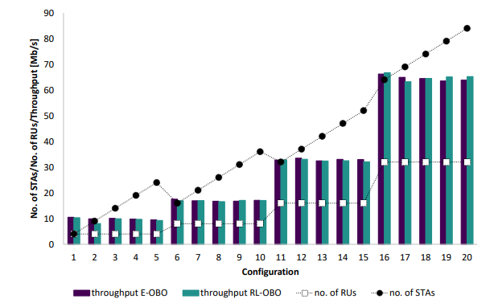
RL vs standard ‘rule-based’ protocols? UORA example
Conclusions: “The simulation results confirm that the proposed approach gives satisfactory results in various dynamic settings; however, when compared to E-OBO, RL-OBO does not provide meaningful advantages. Both mechanisms provide similar outcomes (i.e., throughput, channel access fairness, efficiency) and, therefore, the need for RL-OBO training and appropriate configuration of ML-related hyperparameters becomes a disadvantage.”
Heuristic
RL

Slide 55
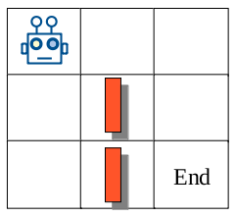
Actions, Rewards and States
Consider the case of a robot moving in a map.
Each position of the map is a ‘state’: (x,y)
Actions: the movements that can be done in each state: U, D, R, L
Rewards: how close is the robot to the end; and/or if there is an obstacle.
Moving results in a reward, but also moves the system to a new state.
Learning the model means knowing what to do (action to play) at every state.
It is not clear how to define states in Wi-Fi, as sometimes the state is equivalent to the ‘action’ (i.e., the selected AP or channel).
Wireless scenarios are hardly ‘static’, and so the same action may have different outcomes.
Notes:
Explaining RL requires to understand what are the actions, the rewards and the states. Let’s consider an example: a robot that moves in a map, and has to finish the ‘End’.
The map can be divided in different positions / areas, and each position is an ‘state’. The robot can move through different states in the map.
The actions are then the movements that can do the robot: up, down, left, right.
Since the goal is to find the ‘End’ position, the reward received by the robot could be how close is to the end.
Note that every time the robot moves, the state changes, and from different states, and not all states have the same good actions
While in the case of the map is easy to define states, as the robot changes its position, it is not the same in Wi-Fi. What is an state in Wi-Fi? The channel? Well, choosing a certain channel could be the action too, so in many cases states and actions are exactly the same.
Another thing to take into account is that Wi-Fi networks are not static, and so depending on what we use to decide the reward, it can change from time to time. So we will need to be learning all the time. It would be the same as in the robot case, the two orange walls in the map change from time to time, we will need to learn other paths.

Slide 56
Actions, Rewards and States
After training, we will get the Q-table showing which are the best actions in each state.
Any other robot deployed in the same scenario can use the same Q-table to move around.
What happens if the ‘End’ place changes? Or the obstacles?
The Q-table (the model) needs to be retrained
Can it be done on-line?
Yes, but it needs time to move from previous model to the new one
The robot needs to explore from time to time, or when an anomaly is detected

Slide 57
Defining States
AP selection, channel selection:
states are equivalent to actions since it is hard to find any sequential dependence between channels or APs
MCS selection:
States: the set of possible MCSs; Actions: increase, decrease, keep the same
Allowing to switch from any MCS to any other MCS maps states with actions
If there are any require sequence to follow, it should appear in the trained model
#1
#2
#3
#1
#2
#3

Slide 58
What about more complex cases?
We can put many parameters in one state:
Parameters we can play with: TxP, CCA, MCS, channel width, primary channel
Observations from the environment
Actions can affect a single or multiple parameters every time
If we consider 4 possible values for each parameter, we have: 4*4*4*4*4 = 1024 states
Number of actions: {increase, decrease, keep} for all 5 parameters: 3^5 = 243 combinations
Adding another parameter means: 4096 states and 729 possible combinations

Slide 59

Designing Rewards
A key aspect since it guides the behavior of the RL algorithm
It can be a single value (last action), an average, the sum…
Last value: fluctuations;
Average: low response, as it depends on the past
Q-learning rule: trade-off between past, current and future rewards
Some algorithms require normalized rewards (i.e., [0,1])
So?
For each problem, test different ones, and select the one working better.

Slide 60



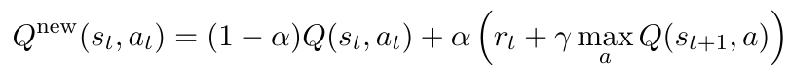
Q-learning
 |  | action
 |  | a₁ | a₂ | …
state | s₁ | val_{1,1} | val_{1,2} | …
 | s₂ | val_{2,1} | val_{2,2} | …
 | … | … | … | …
action
It requires states:
Same or different actions depending on the state
Actions can result in a ‘change’ of state
Rewards depend on the state
We need a mechanism to explore the environment
e.g., ε-greedy
We need a mechanism to update Q-table based on the obtained rewards (Bellman eq.)
state
value
Notes:
Likely, the most representative RL technique is QL. In this case, we define states, and so different actions can be taken in different states.
A key aspect of QL is the way that rewards re computed. In this case, since we have states, we can take also into account what will happen after moving to a new state, and take that into account now, to make current decision. i.e., I put in the equation future rewards if I take now this action.

Slide 61
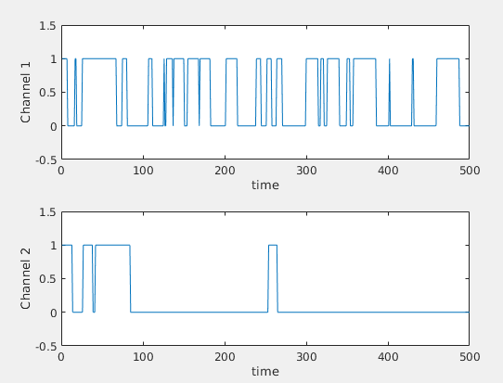
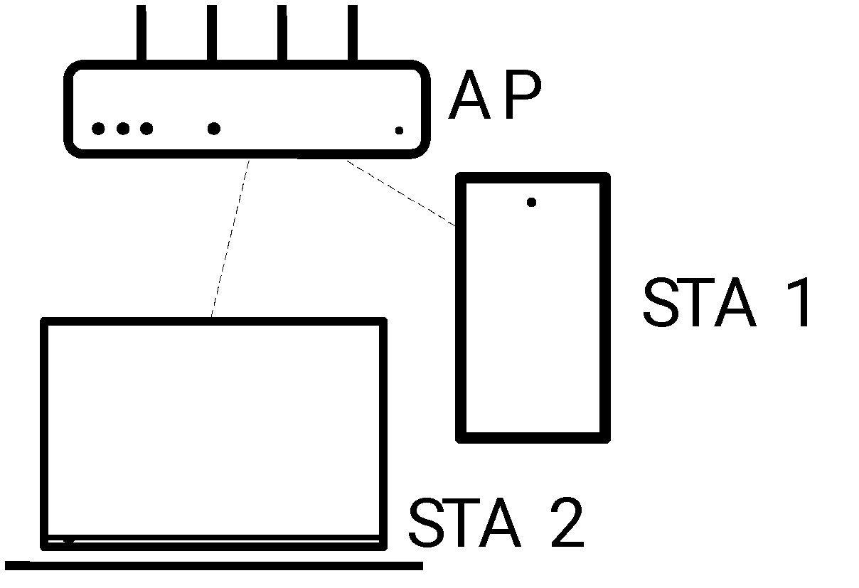
Example: Channel Selection (Q-learning)
remain
channels
1
2
?
Smart AP
change
A channel can be busy or empty
Actions: remain in the same channel; change channel
States: channel 1 and empty; channel 1 and busy; channel 2 and empty; channel 2 and busy
Notes:
Here we have an example of QL with only 2 channels.
In this case, the channel could busy or empty. The state are defined as the channel used, and if the channel is busy or idle. Then, the agent has to decide to switch or to remain, and depending on the channel occupancy the prob. of those actions will be different.

Slide 62
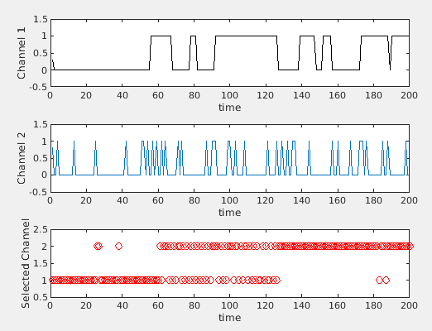
Example: Channel Selection (Q-learning)
channels
1
2
?
Smart AP
a)
b)
c)
Notes:
In this example, while channel 1 remains idle or busy for ‘long’ periods of time, channel 2 is mostly empty, but switches often to busy for very small periods of time.
What is learning the agent? Well as we can see in the yellow area, it prefers to stick to channel 2 even if channel 1 in that window would be better. Why? It has learn that even if channel 2 is busy right now, it will become idle soon. Instead, if it switches to channel 1, and it is busy, it will have to switch to channel 2 again.
a) The agent is happy on channel 1 as it is empty; b) the agent explores both channels, as channel 1 becomes busy; c) the agent prefers channel 2, as it learns that even if it changes often to busy, it goes back to idle fast.

Slide 63
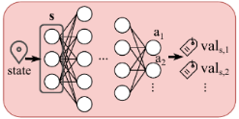
Deep Q-learning (DQN)
s
a₁
Problem: Accurate learning of the Q-table is difficult (or impossible) and time consuming when the number of states is large as the agent needs to go through all the different states and actions several times.
…
val₁
a₂
state
…
val₂
Solution: Model the Q-table response with a (Deep) Neural Network.
If the system is in state ‘s’, the agent asks the (D)NN to predict the reward the agent will obtain if it plays any of the available actions in state ‘s’.
The agent selects the action with a higher predicted ‘reward’.
DQN’s additional deep neural network allows for more efficient extrapolation of rewards for yet unseen states as compared to basic Q-learning.
Challenge: to train on-line the (D)NN, as it may require large CPU/GPU resources.
Notes:
The Q-table can become large if there are many states.
If we replace the table with a DNN, we get DQL (usually referred to as DQN).
We can now predict the reward, even for unseen states.
The downside is the additional computational power.

Slide 64
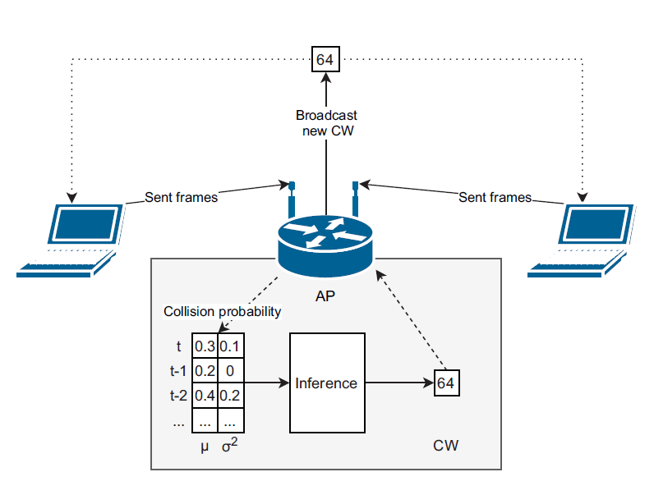


Example: DQN for CW optimization
Agent - installed at the AP
State - status of all connected devices
Action - select CW (value of integer a)
Reward - network throughput
Observation - collision probability
DNN: 8 × 128 × 64
Exploration: random action w/ low probability
Wydmański, Witold, and Szymon Szott. "Contention window optimization in IEEE 802.11ax networks with deep reinforcement learning." In 2021 IEEE Wireless Communications and Networking Conference (WCNC).
Notes:
The proposed solution for selecting optimum CW values comprises the following RL elements.
Central agent which sets CW values for all stations (broadcast in beacons).
The action is a parameter in the CW equation.
The AP is in a position to monitor network throughput.
The collision probability observations must be done at stations and sent to the AP.
We also address the exploitation vs exploration tradeoff.

Slide 65


Example cont’d
DQN - Discrete action space
DDPG - Continuous action space
Mean selected CW in consecutive training rounds
(static scenario: 30 stations)
Throughput improvement over 802.11
Notes:
Results are shown for DQN and another Q-learning method (DDPG, Deep Deterministic Policy Gradient).
The chart on the left shows how the RL agent performs in consecutive training rounds for a static scenario.
The select CW converges for more rounds and more experiment repetitions (small CIs).
The chart on the right shows how much we can improve over 802.11 if we optimize CW.
The look-up table approach represents the upper bound, which both ML methods are able to reach.

Slide 66


How well does offline training in RL work?
pre-trained
(40 input, 45 output)
s
a₁
Deep Reinforcement Learning for Dynamic Network Slicing in IEEE 802.11 Networks
Some sentences: “a model of the network environment is not feasible in practice”; “gigantic state-action space that cannot be learned completely within a steady period of the network”;
Enhanced with an off-line learning step: Fitted Q-iteration → use of a pre-trained NN
…
val₁
a₂
state
…
val₂

Slide 67



How well does the offline training in RL work?
[194] Deep Reinforcement Learning for Dynamic Network Slicing in IEEE 802.11 Networks
Performance evaluation: same scenario used for training the NN.
De Bast, Sibren, Rodolfo Torrea-Duran, Alessandro Chiumento, Sofie Pollin, and Haris Gacanin. "Deep reinforcement learning for dynamic network slicing in IEEE 802.11 networks." In IEEE INFOCOM 2019-IEEE Conference on Computer Communications Workshops (INFOCOM WKSHPS), pp. 264-269. IEEE, 2019.

Slide 68


Federated Learning
Federated Learning: devices exchange their locally trained ‘global’ models.
Centralized or distributed.
The ‘global’ model is re-trained locally using the data gathered by each device.
Only the ‘model’ is shared by participating devices. Data is kept local (privacy advantages + saves overheads).
SL: the weights of a NN
RL: Q-table, instantaneous rewards
The global model aggregates the weights from the local updates computed by clients (typically, FedAvg is adopted)
Could improve system stability in ‘adversarial’ situations
Example / Proposal
To leverage the over the air MAPC framework to exchange local models to support DFL in next-gen. Wi-Fi networks
Notes:
Szymon
An emerging approach that could be suitable for Wi-Fi is Federated Learning. In Federated Learning, the different agents exchange their models or related parameters.
It can be implemented either in a centralized or distributed way.
Once the ‘global’ model is deployed, it is re-trained ‘locally’ using the data available at each device, and the resulting model is shared again.
To support FL in Wi-Fi, we will need a framework to exchange the model parameters similar as it is done with the beamforming and buffer reports. In case the APs are the devices equipped with an agent, we may consider to add these features as part of a Multi-AP Coordination framework.
Algorithm 1 is from Wilhelmi, Francesc, Jernej Hribar, Selim F. Yilmaz, Emre Ozfatura, Kerem Ozfatura, Ozlem Yildiz, Deniz Gündüz et al. "Federated Spatial Reuse Optimization in Next-Generation Decentralized IEEE 802.11 WLANs." arXiv preprint arXiv:2203.10472 (2022).

Slide 69


Transfer Learning: an example
Source: Iturria-Rivera, Pedro Enrique, Marcel Chenier, Bernard Herscovici, Burak Kantarci, and Melike Erol-Kantarci. "Cooperate or not Cooperate: Transfer Learning with Multi-Armed Bandit for Spatial Reuse in Wi-Fi." arXiv preprint arXiv:2211.15741 (2022).
Each AP has an agent in charge of selecting the best TxPower and CCA threshold.
Before selecting an action, the reward is predicted using a DNN, which is trained for each scenario (context)
In dynamic scenarios, when there is a context change, the previous trained DNN is ‘transferred’ to the new one: a) completely, or b) partially (a subset of layers).

Slide 70
Re-cap
Machine Learning → techniques to create ‘models’ from data
Supervised Learning: Make predictions, classify
Unsupervised Learning: leverage similarity
Reinforcement Learning: interact with the environment
Training and deploying models:
Off-line vs On-line
Centralized vs Distributed
Use-cases / Examples:
Pre-trained SL models for AP selection (association)
RL for CW/channel selection in dynamic environments
The capability of ML to go beyond rule of thumb strategies by automatically learning (and adapting) to (un)seen situations can cope with heterogeneous wireless network scenarios
Notes:
Szymon
To summarize this first part, we have defined…

Slide 71
Outline
Part 1: Introduction. Why Wi-Fi may want to adopt AI/ML? (30 mins) - Katarzyna
Wi-Fi overview: A 30-year path from IEEE 802.11b to IEEE 802.11be, and beyond.
Open challenges in Wi-Fi: Dealing with complexity and uncertainty.
Requirements of next-gen WiFi networks.
Part 2: A primer on AI/ML (45 min) - Szymon & Boris
Concepts, definitions, and overview of the main ML types (supervised, unsupervised, and reinforcement learning), including Wi-Fi examples.
Popular ML techniques and paradigms: deep learning, reinforcement learning, online learning, federated learning.
Deployment options: architecture, data handling, marketplaces.
Break (10:00-10:30)
Part 3: Multi-Armed Bandits for Responsive Wi-Fi networks (45 mins) - Boris & Szymon
Multi-Armed Bandits: exploitation-exploration trade-off; e-greedy, Thompson Sampling, UCB.
Examples: Channel Selection; AP selection;
Reinforced-lib + Example (MCS selection).
Part 4: Wi-Fi & ML: Practical considerations (45 mins) - Francesc
Wi-Fi & ML: A two-sided relationship
Adoption of ML in Wi-Fi
Wi-Fi in the ITU-T AI/ML in 5G Challenge: Use cases, tools, and results from the 2020-2022 editions
Hands-on Exercise II: Predicting the performance of Wi-Fi through Deep Learning
Part 5: Open challenges, future research directions, and summary (15 mins) - Katarzyna
Open challenges and future research directions; Synergies with other disruptive technologies.
Current AI/ML trends: LLM and Generative AI.
Summary and takeaways.
Notes:
Szymon
Once we have overview the main ML techniques, let’s move to another important concept: model training and deployment

Slide 72
3 Multi-Armed Bandits (MABs) for Responsive Wi-Fi networks

Slide 73


Motivation
There are multiple random phenomena that could affect Wi-Fi performance
Variable traffic
Variable channel conditions
Variable number of contenders
Variable OBSS interference/contention
Environment changes fast: is it stationary or non-stationary?
Hard to find an ‘optimal’ configuration for all conditions.
Can ‘AI/ML’ agents deployed in AP / stations help?
It will need to learn and react fast
One big ‘agent’ or multiple ‘small agents’?
Varying OBSS interference/contention
(unlicensed bands)
Varying
Number of Stations
Varying
Traffic
Varying
Channel

Slide 74

Motivation
The ML algorithm controls how the ‘agent’ explores (collects new information) and exploits what has already learnt
Varying OBSS interference/contention
(unlicensed bands)
actions
ML
algorithm
The environment
Varying
Number of Stations
rewards
Varying
Traffic
Requirements / Constraints
Varying
Channel
Goal: achieve the requirements using the minimum possible resources
Multi-armed Bandits (MABs) seem good candidate as light-weight ML algorithms to drive the exploration / exploitation trade-off

Slide 75

Multi-armed Bandits (MABs)
action | value
a₁ | val₁
a₂ | val₂
… | …
Sequential interaction between the ‘agent’ and the environment:
action 1 → reward 1; action 2 → reward 2
No states (or just a single state), only actions and rewards.
Exploration-exploitation trade-off. The agent:
Explores: selects an action ‘randomly’
Exploits: selects the action with higher reward from the table
Different approaches: simple, low-computing res.
ε-greedy, Thompson Sampling, UCB, EXP3, etc.
Contextual MABs take into account different situations:
E.g. AP selection at home, at work
Moving to a new ‘context’ may allow to reuse past info.
action
value
Wilhelmi, F., Cano, C., Neu, G., Bellalta, B., Jonsson, A., & Barrachina-Muñoz, S. (2019). Collaborative spatial reuse in wireless networks via selfish multi-armed bandits. Ad Hoc Networks, 88, 129-141.
Notes:
Boris
So, the first group of RL techniques are called Multi-armed bandits, and they model a sequential interaction between the agent and the environment.
There are no states, only actions and rewards. So, the agent can explore: select a random action, or exploit, select the action that in the past gave us the highest reward
While there are no states, there is nothing that prevents adding extra info regarding the context, and identifying the context, we can apply different actions.

Slide 76
Multi-armed Bandits (MABs) - To know more
Baseline:
Katehakis, M. N., & Veinott Jr, A. F. (1987). The multi-armed bandit problem: decomposition and computation. Mathematics of Operations Research, 12(2), 262-268.
Gittins, J., Glazebrook, K., & Weber, R. (2011). Multi-armed bandit allocation indices. John Wiley & Sons.
Auer, P., Cesa-Bianchi, N., & Fischer, P. (2002). Finite-time analysis of the multiarmed bandit problem. Machine learning, 47(2-3), 235-256.
Auer, P., Cesa-Bianchi, N., Freund, Y., & Schapire, R. E. (1995, October). Gambling in a rigged casino: The adversarial multi-armed bandit problem. In Foundations of Computer Science, 1995. Proceedings., 36th Annual Symposium on (pp. 322-331). IEEE.
Overviews:
Bubeck, S., & Cesa-Bianchi, N. (2012). Regret analysis of stochastic and nonstochastic multi-armed bandit problems. Foundations and Trends® in Machine Learning, 5(1), 1-122.
Vermorel, J., & Mohri, M. (2005, October). Multi-armed bandit algorithms and empirical evaluation. In European conference on machine learning (pp. 437-448). Springer, Berlin, Heidelberg.

Slide 77
Is it not better to have ‘states’?
[Obvious] It depends on the problem…
Note that the ‘state’ definition in RL implies that agent’s actions allow to change from one to another state
In many problems, the goal is not to change the state, if not that given an state (or better a context), we find the ‘configuration’ that is best performing
Example: CW adaptation given the number of stations with non-empty buffers
Context: number of stations with non-empty buffers
Actions: CW = [1, 2, 3, …, 16]
Finding the best CW value can contribute to change the number of stations with non-empty buffers, though it depends on many more things (i.e., buffered packets, MCS, etc.)
Varying OBSS interference/contention
(unlicensed bands)
Varying
Number of Stations
Varying
Traffic
Varying
Channel

Slide 78

What about using SL models?
Varying OBSS interference/contention
(unlicensed bands)
That’s a great idea!
Do we have all input parameters of the SL model?
Yes: we can reduce the exploration!
No: we need to explore first to gather those input parameters
Is the SL model general enough to work on the particular environment we have? We don’t know…
Combining RL/MABs + SL models (trained using the gathered data) is —perhaps— a good option!
Varying
Number of Stations
Varying
Traffic
Varying
Channel
Agents should be able to adapt to new environments (or changes in) without any previous knowledge (model-free).

Slide 79
Single vs Multi-agent set-ups
Multiple devices/networks trying to find a good configuration may result in a never-end story.
Even if there is a joint action, it is unlikely that all agents choose the ‘right’ action at the ‘right’ moment.
That optimal action for the entire network may be suboptimal for some individual ‘agents’, and so the equilibrium is fragile.
To solve this problem,
temporal randomization can be applied (learn by turns): Agents learn only in certain periods of time. Idea: the best for me, it is the best for the others (not always true)
sharing information, and reaching consensus (federated learning)

Slide 80

MAB Examples
Is the research community using MABs?
Check our survey! Many papers using MABs.
Some recent ones (Google Scholar)
Channel selection
We introduce 3 basic MAB algorithms
S. Barrachina-Muñoz, et al.. "Multi-armed bandits for spectrum allocation in multi-agent channel bonding WLANs." IEEE Access 9 (2021): 133472-133490.
AP selection in multi-AP networks
A good lesson from multi-agent environments
M. Carrascosa, et al. "Multi-armed bandits for decentralized AP selection in enterprise WLANs." Computer Communications 159 (2020): 108-123.
Reinforced-lib – universal RL library
Analysis of MABs for rate selection: ε-greedy, UCB, TS, EXP3, Softmax
Since 2019: About 457 results (0.07 sec)
Notes:
Boris
So, the first group of RL techniques are called Multi-armed bandits, and they model a sequential interaction between the agent and the environment.
There are no states, only actions and rewards. So, the agent can explore: select a random action, or exploit, select the action that in the past gave us the highest reward
While there are no states, there is nothing that prevents adding extra info regarding the context, and identifying the context, we can apply different actions.

Slide 81

Example: Channel Selection (MABs)
1
2
3
N
ρ(i) = Occupancy of channel i [0,1]
(measured every 1 second)
channels
0
a_{i}
b_{i}
1
?
Smart AP
Reward using channel i: 1-ρ(i)
Only the channel in use can be measured
Notes:
Boris
In this example, our AP has to find the best suitable channel.
In the following example, the highest long term reward will be given by Channel 2, even if channel 3 can give higher instantaneous values. So our agent has to learn that.

Slide 82

Sequential Exploration (Brute Force)
We check sequentially all channels, and select the ‘best’ one for the rest of the time.

Slide 83

𝜀-greedy
Direct implementation of the Exploitation / Exploration trade-off
Explore with probability 𝜀
Exploit with probability 1-𝜀
Performance of 𝜀-greedy can be improved by:
[Not a general rule, depends on the problem]
Updating the value of 𝜀 as the system is learning
Adjusting how the average reward for every action is selected (i.e., weighted average)

Slide 84


𝜀-greedy
N=4 channels
1 episode, 50 iterations
𝛼=0.5; 𝜀₀=0.2 (constant)
Notes:
Boris
It then starts exploring different channels, until it learns than channel 2 is the one that gives higher rewards.

Slide 85


𝜀-greedy
N=4 channels
1 episode, 50 iterations
𝛼=0.5; 𝜀₀=0.8 (reduces 0.02 per step)
Notes:
Boris
It then starts exploring different channels, until it learns than channel 2 is the one that gives higher rewards.

Slide 86



Thompson sampling
We assume the reward of each action follows a Gaussian distribution (it could be another one).
For each action, we estimate its mean, and adjust the variance proportionally to the number of times we played that action in the past:
the variance ‘captures’ how much confident we are on the future reward we will obtain when playing a certain arm.
TS includes the ‘consolidated’ knowledge of a certain action when deciding to take it or not: i.e., playing arm 1 may give me higher reward, but I have more uncertainty.

Slide 87


UCB - Upper Confidence Bound
c=1/K
Brute force + pick the best ‘action’
Optimistic Function to explore:
if I have not tried an action for a while (as it was not good), perhaps now it has changed
The value of ‘c’ depends on the reward range of values, and allows to adjust the exploration

Slide 88



And the winner is…
We compare all 4 algorithms
100 episodes (each one of 50 iterations)
(still 50 iterations per episode)
4 channels
24 channels
48 channels

Slide 89
Is it easy to implement?
The AP stores the estimated occupancy of every visited channel (including the actual one).
The AP switches the Wi-Fi network periodically to a new channel following the ML algorithm using ‘Channel Switch Announcement’ elements in beacons.
Decision to switch (based on rewards and exploration rate) should take into account not only the channel occupancy but also network state and traffic load.
The AP can activate the ‘channel search’ agent only when current performance is below its needs.
Inactivity periods can be used to gather statistics from the other channels if the system is stationary.
Varying
Number of Stations
Varying
Traffic
Varying
Channel

Slide 90


ML-enhanced Decentralized Spectrum Allocation
S. Barrachina-Muñoz, et al.. "Multi-armed bandits for spectrum allocation in multi-agent channel bonding WLANs." IEEE Access 9 (2021): 133472-133490.

Slide 91

ML-enhanced Decentralized Spectrum Allocation
“Realistic” Wi-Fi simulation environment (Komondor)
Path-loss, SINR, Dyn. Bandwidth Access, etc.
Traffic load AP (only DL traffic): 50 Mbps
80 MHz available (shared by all 4 BSSs)
W=20, 40 and 80 MHz
12 different channels (width, primary) → 12 actions per BSS
4 x 20 MHz channels (1 position for the primary)
2 x 40 MHz channels (2 positions for the primary)
1 x 80 MHz channels (4 positions for the primary)
The goal is to ‘learn’ a good channel allocation as fast as possible
Notes:
Boris
A relatively similar problem as the previous one is Channel Selection: Each BSS decides which channel to use (width, and primary position). Moreover, in this work, we aim to learn a ‘good’ channel allocation as fast as possible, since network conditions may change.
To do this study, we use a (reasonably) realistic simulator that implements DCF, supports dynamic bandwidth access, and accurate PHY and channel models. For example, the simulator captures the effect on different channel widths on the coverage area of each BSS, with larger channel widths allowing for shorter coverage areas.
We start considering a toy scenario with 4 APs and 4 STAs, placed at well known positions, so studying it will help to understand the obtained results.

Slide 92


ML-enhanced Decentralized Spectrum Allocation
Multi-armed Bandits (expfirst, e-greedy, TS, …)
Available actions correspond to the set of available channels
12 actions
Rewards are computed taking into account the actual throughput during the simulation (in intervals of 5 s)
50 Mbps constant load (in average, Poisson traffic) per BSS
Channel switching time not considered (few ms)
Practical considerations:
Easy to implement on top of current 802.11 devices
Channel switching overheads need to be considered
Notes:
Boris
Since we target a fast channel allocation, we resort again on MABs, where the available actions correspond to the available number of channels (12 actions).
Rewards are computed using an average window of 5 seconds, but channel switching times - which should be of few msecs- are not considered. We tested different durations, and 5 seconds was enough to get a stationary throughput value.
As in the previous example, an easy to implement mechanism on top of current 802.11.

Slide 93
ML-enhanced Decentralized Spectrum Allocation
expfirst:
sequential exploration + actions sorted by reward (and stored)
action change when current av. reward decreases below others
e-greedy, TS, UCB, EXP3
The data set:
https://zenodo.org/record/4265898#.Y5nS3NLMJ8I
Notes:
Boris
Since we target a fast channel allocation, we resort again on MABs, where the available actions correspond to the available number of channels (12 actions).
Rewards are computed using an average window of 5 seconds, but channel switching times - which should be of few msecs- are not considered. We tested different durations, and 5 seconds was enough to get a stationary throughput value.
As in the previous example, an easy to implement mechanism on top of current 802.11.

Slide 94

ML-enhanced Decentralized Spectrum Allocation
Unstable!
Why?
Only the simplest MAB algorithms perform well → they are able to find an acceptable equilibrium
Notes:
Boris
We test different MABs algorithms, showing that the simplest ones are the most effective. Indeed, they are the only ones able to converge to a solution, which is not the same in all cases.
The best performing one is exploration first. It is extremely simple: it first checks all options, selects the best one, and only changes if the reward of the selected option goes below another one, even if the reward from the others is ‘outdated’.
So, here the message is to be cautious on what we want to do with ML, as in many cases simple solutions that extend rule-based protocols to give them some ‘adaptability’ may be enough.

Slide 95

ML-enhanced Decentralized Spectrum Allocation
We now consider a traffic load pattern where each BSS w changes its mean traffic load to 20, 50 or 150 Mbps every 100 iterations uniformly at random.

Slide 96

ML-enhanced Decentralized Channel Selection
Large deployments:
20x20 m^2
6, 10 and 16 BSSs
Random per BSS traffic loads: 50, 100, 150 Mbps
W = 20, 40, 80, 160 MHz
160 MHz available spectrum
32 combinations of channels
Both exploration-first and e-greedy can learn even in high-density deployments, outperforming by far static configurations. Besides, while exploration-first performs worse than e-greedy at the early stages of the simulation, it reaches much better performance as the simulation progresses.
Notes:
Boris
To conclude this example, we validate the performance of the MABs algorithm in high-density scenarios.
We now consider ‘random scenarios’, deploying 6, 10 and 16 BSSs in a 20x20 m^2 area, considering only exp-first and epsilon greedy MABs.
Results confirm that both schemes are able to learn in high-density deployments, showing that epsilon greedy is able to provide better results in the short term, but in the long term, exp-first is the one that obtains the higher performance.
In general, these results call into question whether the use of complex RL algorithms actually helps the quest and derive that stateless algorithms, especially in the form of lightweight MABs, are an efficient solution for rapid adaptation avoiding extensive or meaningless states.

Slide 97

Lightweighting The Action Space
Is it possible to increase the learning convergence speed and reach good performance levels sooner?
To that aim, we propose lightening the action space of each agent by reducing the possible values the maximum bandwidth attribute may take: from b ∈ {1, 2, 4, 8} to b ∈ {1, 8}, i.e., to allow only single-channel (b = 1) or to remove any bandwidth restriction (b = 8).
Reduced action space (16 actions instead of 32)
So, is there any rule of thumb for reducing action spaces?
Adding new actions progressively?

Slide 98




Different Rewards
Only throughput satisfaction:
Throughput and delay:
Idea: Given you get the required throughput, minimizing the delay means you are better using the available resources → more available resources for the other BSSs.

Slide 99
MAB Examples
Is the research community using MABs?
Check our survey! Many papers using MABs.
Some recent ones (Google Scholar)
Channel selection
We introduce 3 basic MAB algorithms
We introduce 3 basic MAB algorithms
S. Barrachina-Muñoz, et al.. "Multi-armed bandits for spectrum allocation in multi-agent channel bonding WLANs." IEEE Access 9 (2021): 133472-133490
AP selection in multi-AP networks
A good lesson from multi-agent environments
M. Carrascosa, et al. "Multi-armed bandits for decentralized AP selection in enterprise WLANs." Computer Communications 159 (2020): 108-123.
Reinforced-lib – universal RL library
Analysis of MABs for rate selection: ε-greedy, UCB, TS, EXP3, Softmax
Since 2019: About 457 results (0.07 sec)
Notes:
Boris
So, the first group of RL techniques are called Multi-armed bandits, and they model a sequential interaction between the agent and the environment.
There are no states, only actions and rewards. So, the agent can explore: select a random action, or exploit, select the action that in the past gave us the highest reward
While there are no states, there is nothing that prevents adding extra info regarding the context, and identifying the context, we can apply different actions.

Slide 100

ML-enhanced Decentralized AP selection
Default AP selection is implemented considering only RSSI values
A station associates to the ‘closest’ AP
This may cause that some APs are overloaded, while others are almost empty
ML solution: STAs use an ML agent to find an AP that is good enough to satisfy their traffic requirements.
The ML agent implements a MAB:
Actions: APs in sight
Reward: ratio Throughput/Load
Notes:
Boris
By default, AP selection in Wi-Fi is a decentralized process. Stations associate to the closest AP from the point of view of the received signal level. In scenarios with many STAs in the same area, this approach may overload few APs, while others remain idle.
To tackle this situation, in this particular case, we propose to deploy ML-enhanced agents in the stations able to find which is the best AP to associate. The goal of each agent is to find an AP able to satisfy station requirements.

Slide 101

ML-enhanced Decentralized AP selection
Default ε-greedy MAB is enhanced with ‘stickiness’.
Stickiness aims to improve stability by reducing the number of STAs switching APs simultaneously, or in a short time interval
Idea: STAs stick to the last AP that satisfied their requirements for several association rounds before switching
Notes:
Boris
The agent uses a simple Multi-Armed Bandit scheme, where the set of actions of each agent correspond to the set APs in sight (from it), and the reward is the ratio throughput/load.
A particular contribution of this work is the ‘stickiness’ concept, which aims to reduce the number of stations switching APs at the same time, thus reducing the network variability and so, make easy to learn.
The main idea is to stick to the last ‘satisfactory’ AP even if currently it is offering a poor performance.

Slide 102


ML-enhanced Dec. AP sel.
Non overlapping channel allocation
16 APs, 64 STAs
Load STA: 4 Mbps
Notes:
Boris
In scenarios where APs are deployed in a grid (i.e., an airport), with a proper channel allocation that minimizes interference, and the stations are distributed in ‘clusters’, we can see how the performance of all stations progressively improves with time, as they find good associations, and in few iterations most of the stations are satisfied.
Note this is a worst case scenario where all stations appear at the same time. It is likely that if stations appear progressively, given the already associated ones are satisfied, a solution for the new arriving ones will be found much faster.

Slide 103

ML-enhanced Dec. AP sel.
Pros:
Easy to implement without any major update on 802.11 devices
All network devices benefit even if they are not ML-enhanced
Fully decentralized solution
Reactive, adapts to any environment
Cons:
Learning by interacting with the environment is required, implying periods of ‘low performance’ due to bad choices
AP switching overheads
Practical aspects:
Temporal window to assess throughput performance
Notes:
Boris
An important result from using this mechanism is that all stations benefit from having some stations implementing this ML mechanism , even if they are not ML-enhanced. Also, as more stations are enhanced with the ML mechanism, the results further improve, which is also a positive aspect of the proposed mechanism.
Overall, it is an easy to implement solution, without any major update in 802.11 devices, fully decentralized, and able to work in any scenario.
The downside, however, is that it takes time to converge, and there is the AP switching overheads.
To implement it in practice, the throughput distribution in a temporal window is an important parameter to take into consideration, as depending on the application, the satisfaction definition could be more complex than just the ability to deliver a certain amount of traffic.
This approach is compatible with the use of SL pre-trained models to select APs, or even with managed solutions that prevent stations to associate to APs that are already overloaded.
Notes
Indeed, this can work very well with MLSR.

Slide 104


ML-enhanced Dec. AP sel. vs Load-aware AP sel.
Notes:
Boris
To finish this example, a natural question is if a Load-aware AP selection mechanism could perform better. In this example, we test a very simple algorithm: when an station has to switch to another AP, it selects the less loaded AP in sight -we assume the station has such an information (to check in the paper).
We can see that the heuristic algorithm improves the performance faster - in few iterations - but the ML-enhanced one is able to find better solutions in terms of performance in the long-term.
An obvious conclusion here is to combine both approaches could be positive.

Slide 105
MAB Examples
Is the research community using MABs?
Check our survey! Many papers using MABs.
Some recent ones (Google Scholar)
Channel selection
We introduce 3 basic MAB algorithms
We introduce 3 basic MAB algorithms
S. Barrachina-Muñoz, et al.. "Multi-armed bandits for spectrum allocation in multi-agent channel bonding WLANs." IEEE Access 9 (2021): 133472-133490
AP selection in multi-AP networks
A good lesson from multi-agent environments
M. Carrascosa, et al. "Multi-armed bandits for decentralized AP selection in enterprise WLANs." Computer Communications 159 (2020): 108-123.
Reinforced-lib – universal RL library
Analysis of MABs for rate selection: ε-greedy, UCB, TS, EXP3, Softmax
Since 2019: About 457 results (0.07 sec)
Notes:
Boris
So, the first group of RL techniques are called Multi-armed bandits, and they model a sequential interaction between the agent and the environment.
There are no states, only actions and rewards. So, the agent can explore: select a random action, or exploit, select the action that in the past gave us the highest reward
While there are no states, there is nothing that prevents adding extra info regarding the context, and identifying the context, we can apply different actions.

Slide 106


Reinforced-lib
https://github.com/m-wojnar/reinforced-lib

Slide 107

Reinforced-lib: Features
Open-source
Easy-to-use
Extensive documentation
Support for simple (MABs) and deep RL
Export to embedded devices
Provided examples
MAB rate selection
DQN CW selection
pip install reinforced-lib

Slide 108


Reinforced-lib Example: Stationary Scenario

Slide 109


Reinforced-lib Example:
Mobile Scenario

Slide 110
Re-cap
MABs are simple, but powerful algorithms to make Wi-Fi networks ML-aware
They implement the exploration-exploitation trade-off
Engineering (parameter tuning) required to suit different problems
Convergence / responsiveness should be addressed / improved
Examples:
Channel allocation and AP selection can be enhanced with MABs
In dynamic environments, lightweight approaches could be the best ones in terms of the response delay-performance tradeoff
ML agents operation must contribute to reduce the environment randomness
Rate adaptation using MABs can improve traditional rate selection (e.g., Minstrel) algorithms
Reinforced-lib: a tool for lightweight prototyping of RL solutions
Notes:
Szymon
To summarize, we see that mostly RL is used to address multiple features (...) and mostly targeting higher throughput.
Based on the presented examples, we see that…

Slide 111
Outline
Part 1: Introduction. Why Wi-Fi may want to adopt AI/ML? (30 mins) - Katarzyna
Wi-Fi overview: A 30-year path from IEEE 802.11b to IEEE 802.11be, and beyond.
Open challenges in Wi-Fi: Dealing with complexity and uncertainty.
Requirements of next-gen WiFi networks.
Part 2: A primer on AI/ML (45 min) - Szymon & Boris
Concepts, definitions, and overview of the main ML types (supervised, unsupervised, and reinforcement learning), including Wi-Fi examples.
Popular ML techniques and paradigms: deep learning, reinforcement learning, online learning, federated learning.
Deployment options: architecture, data handling, marketplaces.
Break (10:00-10:30)
Part 3: Multi-Armed Bandits for Responsive Wi-Fi networks (45 mins) - Boris & Szymon
Multi-Armed Bandits: exploitation-exploration trade-off; e-greedy, Thompson Sampling, UCB.
Examples: Channel Selection; AP selection;
Reinforced-lib + Example (MCS selection).
Part 4: Wi-Fi & ML: Practical considerations (45 mins) - Francesc
Wi-Fi & ML: A two-sided relationship
Adoption of ML in Wi-Fi
Wi-Fi in the ITU-T AI/ML in 5G Challenge: Use cases, tools, and results from the 2020-2022 editions
Hands-on Exercise II: Predicting the performance of Wi-Fi through Deep Learning
Part 5: Open challenges, future research directions, and summary (15 mins) - Katarzyna
Open challenges and future research directions; Synergies with other disruptive technologies.
Current AI/ML trends: LLM and Generative AI.
Summary and takeaways.
Notes:
Szymon
Once we have overview the main ML techniques, let’s move to another important concept: model training and deployment

Slide 112
4 Wi-Fi & ML: Practical considerations
Wi-Fi & ML: a two-sided relationship
+
Adoption of ML in Wi-Fi
+
Wi-Fi in the ITU-T AI/ML in 5G Challenge
+
Hands-on Exercise II

Slide 113


Wi-Fi for ML & ML for Wi-Fi: A two-sided relationship
Wi-Fi for ML
ML for Wi-Fi
Rise of decentralization in ML (distributed/collective/federated intelligence)
Real-time adaptation in ML applications
Reach end-users, typically available wirelessly
Wireless communications have become essential fuel for AI/ML
Joint ML & communication optimization
ML to address relevant problems in Wi-Fi
Network management & configuration
Advanced troubleshooting & anomaly detection
Network optimization (e.g., channel access, transmit power power adaptation, MCS selection optimization, etc.)
On-top solutions vs Native AI/ML

Slide 114

Wireless for ML: Ongoing work & relevant directions
AI/ML operations relying on wireless links
Exchange data/model parameters
Multi-agent coordination
Distributed inference
Wireless resources have an impact on AI/ML methods
Provide timely results (e.g., spectrum resources)
Reliability, error-free transmissions (e.g., SINR)
Energy consumption (e.g., transmit power)
“Machine learning and wireless communications”
Yonina C. Eldar, Andrea Goldsmith,
Deniz Gündüz, H. Vincent Poor
Collaborative learning over WNs
Optimized FL in WNs with constrained resources
Quantized FL
Over-the-air-computation
Federated knowledge distillation
Differential privacy in wireless FL
Timely wireless edge interference

Slide 115
Examples
Distributed learning over Wi-Fi:
Guerra, E., Wilhelmi, F., Miozzo, M. and Dini, P. (2023), "The Cost of Training Machine Learning Models over Distributed Data Sources," in IEEE Open Journal of the Communications Society, doi: 10.1109/OJCOMS.2023.3274394.
Over-the-air-computation
Amiri, M. M., & Gündüz, D. (2022). “Over-the-Air Computation for Distributed Learning over Wireless Networks.” Machine Learning and Wireless Communications, 434.

Slide 116

Distributed learning over Wi-Fi
Distributed ML trend
Improve efficiency of computation and communication resources
Bring AI optimization closer to users
Robustness, enhanced privacy, security...
Federated Learning (FL)
FL devices exchange model weights rather than data
Communication efficiency
Improve scalability + Enhance privacy
Strong dependency on (wireless) communication links
Significant cost of communication (overhead, energy)
Impact of communication latency into ML performance

Slide 117

Distributed learning over Wi-Fi
Guerra, E., Wilhelmi, F., Miozzo, M. and Dini, P. (2023), "The Cost of Training Machine Learning Models over Distributed Data Sources," in IEEE Open Journal of the Communications Society, doi: 10.1109/OJCOMS.2023.3274394.
Three different FL settings
Centralized Federated Learning (CFL): traditional setting with a central orchestrating server
Blockchained Federated Learning (BFL): the central server is replaced by a distributed ledger
Gossip Federated Learning (GFL): purely decentralized setting with P2P interactions
Cost of training ML models
Computation
Communication:
Cloud link & Edge link (UL/DL)

Slide 118

Distributed learning over Wi-Fi
Guerra, E., Wilhelmi, F., Miozzo, M. and Dini, P. (2023), "The Cost of Training Machine Learning Models over Distributed Data Sources," in IEEE Open Journal of the Communications Society, doi: 10.1109/OJCOMS.2023.3274394.
Number of FL rounds
Model size (kB)
Number of clients/devices
Number of blockchain nodes
Size of popular ML models:
FFNN = 800 KB
CNN = 2.33 MB
Resnet50 = 48 MB
VGG19 = 79 MB

Slide 119
Distributed learning over Wi-Fi
Guerra, E., Wilhelmi, F., Miozzo, M. and Dini, P. (2023), "The Cost of Training Machine Learning Models over Distributed Data Sources," in IEEE Open Journal of the Communications Society, doi: 10.1109/OJCOMS.2023.3274394.
Results of training a CNN in each setting for IID and non-IID (in parentheses) dataset distributions:
Most of the energy spent is devoted to computation tasks (i.e., ML model training)
The communication energy is computed based on the power used for transmission
The communication overheads are significant
Need for a new class of traffic: AI/ML category (under discussion in standardardization)
A significant portion of the literature analyzes ways to decrease the communication overheads generated by FL (compression, quantization, resource allocation, etc.)
Yang, Z., Chen, M., Saad, W., Hong, C. S., & Shikh-Bahaei, M. (2020). Energy efficient federated learning over wireless communication networks. IEEE Transactions on Wireless Communications, 20(3), 1935-1949

Slide 120
Examples
Distributed learning over Wi-Fi:
Guerra, E., Wilhelmi, F., Miozzo, M. and Dini, P. (2023), "The Cost of Training Machine Learning Models over Distributed Data Sources," in IEEE Open Journal of the Communications Society, doi: 10.1109/OJCOMS.2023.3274394.
Over-the-air-computation
Amiri, M. M., & Gündüz, D. (2022). “Over-the-Air Computation for Distributed Learning over Wireless Networks.” Machine Learning and Wireless Communications, 434.

Slide 121


Over-the-air-computation (OAC)
OAC leverages interference from simultaneous transmissions for ML model aggregation/averaging
The medium performs the computation (signal superposition)
Reduce the number of computations
The underlying communication infrastructure needs to be aware of the mechanism:
Schedule devices
Synchronization
Power control
Amiri, M. M., & Gündüz, D. (2020). Machine learning at the wireless edge: Distributed stochastic gradient descent over-the-air. IEEE Transactions on Signal Processing, 68, 2155-2169.
Chen, M., Yang, Z., Saad, W., Yin, C., Poor, H. V., & Cui, S. (2020). A joint learning and communications framework for federated learning over wireless networks. IEEE Transactions on Wireless Communications, 20(1), 269-283

Slide 122


Adoption of ML in Wi-Fi
Architectural solutions
ML Sandbox / Digital twin
Need for procedures, interfaces and data elements to support ML operations
The ITU-T ML architectural framework
Use case: AI/ML-based roaming enabled by the ITU-T’s architecture
Need of tools to trust AI/ML
The ML Sandbox allows training, testing, and evaluating AI/ML solutions before being applied to production networks
The role of network simulators as future network digital twins

Slide 123

Architectural integration of AIML in Wi-Fi
Challenges for ML adoption in Wi-Fi:
Lack of support for ML operations (MLOps)
Data handling (where to store data? how to exchange data? how often measurements are done? etc.), ML model (re)training, ML model inference, ML model deployment
IEEE 802.11 defines MAC/PHY only (limited AI functionalities with respect to 3GPP)
Uncertainty due to the distributed channel access
Different operation modes
Fully decentralized, with autonomous operation (e.g., residential)
Coordinated, allowing for groups of collaborating APs (e.g., Wi-Fi 8)
Centralized, operated from the cloud (e.g., industrial/enterprise Wi-Fi)
Backward legacy compatibility (fair AI solutions are required)

Slide 124

Existing AIML frameworks

Slide 125
The ITU-T’s Flexible ML Architecture
ML operations
Multiple ML pipeline nodes to be instantiated for multiple purposes
Data collection, model inference, output distribution…
Specialized M&O is required (MLFO)
Chain ML pipeline elements
Deploy models, re-train, select data, etc.
ML sandbox (closed-loop subsystem)
Safe environment to assist the ML operation
Increase trustworthiness on AIML
Speed-up model training/validation
Wilhelmi, F., Barrachina-Muñoz, S., Bellalta, B., Cano, C., Jonsson, A., & Ram, V. (2020). A flexible machine-learning-aware architecture for future WLANs. IEEE Communications Magazine, 58(3), 25-31.
Source (src): generates data to be used by the ML mechanism
Collector (C): collects the data generated by sources
Pre-processor (PP): prepares the data collected for its utilization by the ML mechanism
ML model (M): applies the ML model specified by the intent
Policy (P): provides a constraints/guidelines that delimit the behavior of the model
Distributor (D): spreads the ML output across all the corresponding targets (or sinks)
Sink: applies the ML output that is received from the distributor

Slide 126

ITU-T ML architecture’s realization in Wi-Fi
AIML-based roaming

Slide 127

ITU-T ML architecture’s realization in Wi-Fi
AIML-based roaming

Slide 128

ITU-T ML architecture’s realization in Wi-Fi
AIML-based roaming

Slide 129


ITU-T ML architecture’s realization in Wi-Fi
AIML-based roaming
Strongest Signal First (SSF) vs Machine Learning
GitHub - fwilhelmi/machine_learning_aware_architecture_wlans

Slide 130


The ML Sandbox
Y.3181 : Architectural framework for machine learning sandbox in future networks including IMT-2020
F. Wilhelmi, “Building reliability and trust with network simulators and standards”, ITU News Magazine No. 5, 2020

Slide 131

ML Sandbox & Network Digital Twins
Importance of network digital twinning in B5G communications
Network simulators will play an important role
Main responsibilities:
Train AI/ML mechanisms offline
Evaluate the performance of ML models
Generate data for training AI/ML models
Challenges:
Interoperability
Flexibility, compatibility, and suitability
Intent-based operation
Closing the loop
Wilhelmi, F., Carrascosa, M., Cano, C., Jonsson, A., Ram, V., & Bellalta, B. (2021). Usage of network simulators in machine-learning-assisted 5G/6G networks. IEEE Wireless Communications, 28(1), 160-166.

Slide 132


Komondor
Open-source: GitHub - wn-upf/Komondor: Komondor Wireless Networks Simulator
A research and educational tool to simulate IEEE 802.11ax features and more
Low-complexity tool (simplified PHY/MAC)
Fast simulations – Very high deployments
Low-cost implementation of novel features, e.g., 11ax SR
Devise preliminary yet reliable results on specific 802.11 features
Includes “in-house” AI/ML operations
Suitable for creating datasets
Good adoption in academia
Cited/used in >25 research works (source: Google Scholar)
Used in two editions of the ITU AI Challenge as a data generator [1], [2]
Wilhelmi, F. et al. (2021). Machine Learning for Performance Prediction of Channel Bonding in Next-Generation IEEE 802.11 WLANs. ITU Journal on Future and Evolving Technologies, Volume 2 (2021), Issue 4 , Pages 67-79.
Wilhelmi, F. et al. (2022). Federated Spatial Reuse Optimization in Next-Generation Decentralized IEEE 802.11 WLANs. ITU Journal on Future and Evolving Technologies, Volume 3 (2022), Issue 2, Pages 117-133.
Barrachina-Munoz, S., Wilhelmi, F., Selinis, I., & Bellalta, B. (2019, April). Komondor: A wireless network simulator for next-generation high-density WLANs. In 2019 Wireless Days (WD) (pp. 1-8). IEEE.

Slide 133


Online agents operation in Komondor
The operation of AP and non-AP devices can be ruled by agents during simulations
Agents run during the simulation
Monitoring performance (passive/reactive)
Internal operation (e.g., training/inference)
Submit configuration changes to devices
Centralized, distributed, and decentralized modes
An example:
Online learning is used by APA to decide the best primary channel
Scenario dependency (awareness of channels’ statuses)
Transitory vs permanent regimes

Slide 134


Komondor as ML Sandbox
Safe AIML model training♣
PoC on model training in Komondor
Characterize the real network in Komondor
Use AIML in Komondor to find a suitable network configuration in terms of tx power
Apply the configuration discovered in the simulator to the real network
Testbed
2 nearby BSSs (1 AP & 1 STA each) using the same channel
Full-buffer traffic generation at APs (iperf)
Traffic analysis at STAs (Wireshark)
Extra spectrum analyzer (Aaronia) to better understand the activity on the selected channel
♣Wilhelmi, F., Carrascosa, M., Cano, C., Jonsson, A., Ram, V., & Bellalta, B. (2021). Usage of network simulators in machine-learning-assisted 5G/6G networks. IEEE Wireless Communications, 28(1), 160-166.
Notes:
Szymon
To summarize, we see that mostly RL is used to address multiple features (...) and mostly targeting higher throughput.
Based on the presented examples, we see that…

Slide 135


Komondor as ML Sandbox
Safe AIML model training♣
AIML method: online decentralized learning (MABs)
Action space: {5, 7, 12, 17, 23} dBm
On-simulation model training results
200 iterations = 200 seconds
♣Wilhelmi, F., Carrascosa, M., Cano, C., Jonsson, A., Ram, V., & Bellalta, B. (2021). Usage of network simulators in machine-learning-assisted 5G/6G networks. IEEE Wireless Communications, 28(1), 160-166.
Notes:
Szymon
To summarize, we see that mostly RL is used to address multiple features (...) and mostly targeting higher throughput.
Based on the presented examples, we see that…

Slide 136

Komondor as ML Sandbox
Safe AIML model training♣
Tx Power | 5 dBm | 7 dBm | 12 dBm | 17 dBm | 23 dBm
Probability | 0.0804 | 0.7889 | 0.0452 | 0.0452 | 0.0503
The best configuration observed in the simulator was 7 dBm (right-top Table)
The right-bottom Figure shows the performance achieved when:
Using the default configuration (maximum power = 23 dBm)
Using the configuration discovered in the simulator (adapted power = 7 dBm)
♣Wilhelmi, F., Carrascosa, M., Cano, C., Jonsson, A., Ram, V., & Bellalta, B. (2021). Usage of network simulators in machine-learning-assisted 5G/6G networks. IEEE Wireless Communications, 28(1), 160-166.
Notes:
Szymon
To summarize, we see that mostly RL is used to address multiple features (...) and mostly targeting higher throughput.
Based on the presented examples, we see that…

Slide 137

Komondor as ML Sandbox
Safe AIML model training♣
Stability of the simulation vs Simulation time
♣Wilhelmi, F., Carrascosa, M., Cano, C., Jonsson, A., Ram, V., & Bellalta, B. (2021). Usage of network simulators in machine-learning-assisted 5G/6G networks. IEEE Wireless Communications, 28(1), 160-166.
Notes:
Szymon
To summarize, we see that mostly RL is used to address multiple features (...) and mostly targeting higher throughput.
Based on the presented examples, we see that…

Slide 138


Wi-Fi in the ITU-T AI/ML for 5G Challenge
2020
2021
IEEE 802.11ax Dynamic Channel Bonding
Potential of Graph Neural Networks (GNNs)
Federated Learning for IEEE 802.11ax Spatial Reuse
Share knowledge with other OBSSs

Slide 139

Komondor as ML Sandbox
Dataset generation for AIML model training
Problem: Lack of data for training AIML models
Proprietary solutions / Competition
Privacy concerns
Cost of data gathering & processing
An appealing alternative: Generate synthetic datasets with network simulators
Komondor datasets:
2020 ITU AI Challenge - IEEE 802.11ax Dynamic Channel Bonding (DCB) dataset♦
2021 ITU AI Challenge - IEEE 802.11ax Spatial Reuse (SR) dataset♠
♦Wilhelmi, F. (2020). [ITU-T AI Challenge] Input/Output of project "Improving the capacity of IEEE 802.11 WLANs through Machine Learning" [Data set]. Zenodo. https://doi.org/10.5281/zenodo.4106127
♠Wilhelmi, F. (2021). [ITU AI/ML Challenge 2021] Dataset IEEE 802.11ax Spatial Reuse (v1.3) [Data set]. Zenodo. https://doi.org/10.5281/zenodo.5656866

Slide 140
2020 ITU AI Challenge results
Characterization of IEEE 802.11ax DCB
Random scenarios generated with Komondor
Type 1: 12 AP, 10-20 STA, three sizes (80x60 m, 70x50 m, 60x40 m)
Type 2: 8 AP, 5-10 STA, three sizes (60x40 m, 50x30 m, 40x20 m)
DCB policy: adapt the bandwidth per transmission
Random allocation of primary channel and channel width
Features:
Node position (x,y,z), node configuration (primary channel, total bandwidth, tx power), RSSI, SINR, interference map...
Goal: predict the throughput per-STA/per-BSS
More information here: 2020 Edition - Wireless Networking (UPF)
Wilhelmi, F., Góez, D., Soto, P., Vallés, R., Alfaifi, M., Algunayah, A., ... & Bellalta, B. (2021). Machine learning for performance prediction of channel bonding in next-generation IEEE 802.11 WLANs. ITU Journal on Future and Evolving Technologies, Volume 2 (2021), Issue 4, Pages 67-79.

Slide 141


2020 ITU AI Challenge results
Characterization of IEEE 802.11ax DCB
*Top-3 solutions
Wilhelmi, F., Góez, D., Soto, P., Vallés, R., Alfaifi, M., Algunayah, A., ... & Bellalta, B. (2021). Machine learning for performance prediction of channel bonding in next-generation IEEE 802.11 WLANs. ITU Journal on Future and Evolving Technologies, Volume 2 (2021), Issue 4, Pages 67-79.

Slide 142

2020 ITU AI Challenge results
Characterization of IEEE 802.11ax DCB
ATARI: a novel architecture proposed by Soto, P. et al.
Based on GNN+CNN to exploit device interactions using graphs
Soto, P., Camelo, M., Mets, K., Wilhelmi, F., Góez, D., Fletscher, L. A., ... & Latré, S. (2021). ATARI: A graph convolutional neural network approach for performance prediction in next-generation WLANs. Sensors, 21(13), 4321.

Slide 143

2020 ITU AI Challenge results
Characterization of IEEE 802.11ax DCB
*Features used per experiment
Soto, P., Camelo, M., Mets, K., Wilhelmi, F., Góez, D., Fletscher, L. A., ... & Latré, S. (2021). ATARI: A graph convolutional neural network approach for performance prediction in next-generation WLANs. Sensors, 21(13), 4321.

Slide 144

2020 ITU AI Challenge results
Characterization of IEEE 802.11ax DCB
Soto, P., Camelo, M., Mets, K., Wilhelmi, F., Góez, D., Fletscher, L. A., ... & Latré, S. (2021). ATARI: A graph convolutional neural network approach for performance prediction in next-generation WLANs. Sensors, 21(13), 4321.
Notes:
The random guesser is a Gaussian distribution generated by the observed throughput values in the dataset. In some experiments (e.g., E5, E6, E8, E13, E14, and E15), the random guesser performs better than some ML approaches since the combination of input features does not benefit from the learning process. In fact, the Gaussian assumption works well in some cases and it is widely adopted in many communications aspects. Moreover, the random guesser performs more or less the same, independent of the input features, while for some experiments, the ML approaches benefit from certain features (e.g., E1, E2). This random guesser includes some basic information and performs better than a best-effort approach. It serves as an upper bound to the ML approaches, as it shows if the ML model is actually learning.

Slide 145

2020 ITU AI Challenge results
Characterization of IEEE 802.11ax DCB
Soto, P., Camelo, M., Mets, K., Wilhelmi, F., Góez, D., Fletscher, L. A., ... & Latré, S. (2021). ATARI: A graph convolutional neural network approach for performance prediction in next-generation WLANs. Sensors, 21(13), 4321.

Slide 146

2021 ITU AI Challenge results
Federated characterization of IEEE 802.11ax SR
Random scenarios generated with Komondor
Type 1: 2-6 AP, 1 STA, restricted distance between APs
Type 2: 2-6 AP, 1-4 STA, restricted distance between APs
Type 3: 2-6 AP, 1-4 STA, unrestricted distance between APs + contexts (variations of the STA positions)
OBSS/PD-based SR is applied
The OBSS/PD threshold is randomly assigned
Features:
Node position (x,y,z), node configuration (primary channel, tx power), OBSS/PD thr., RSSI, SINR, interference map...
Goal: predict the throughput per-STA
More information here: ITU AI Challenge 2021
Wilhelmi, F., Hribar, J., Yilmaz, S. F., Ozfatura, E., Ozfatura, K., Yildiz, O., ... & Bellalta, B. (2022). Federated spatial reuse optimization in next-generation decentralized IEEE 802.11 WLANs. ITU Journal on Future and Evolving Technologies, Volume 3 (2022), Issue 2, Pages 117-133

Slide 147


2021 ITU AI Challenge results
Federated characterization of IEEE 802.11ax SR
Wilhelmi, F., Hribar, J., Yilmaz, S. F., Ozfatura, E., Ozfatura, K., Yildiz, O., ... & Bellalta, B. (2022). Federated spatial reuse optimization in next-generation decentralized IEEE 802.11 WLANs. ITU Journal on Future and Evolving Technologies, Volume 3 (2022), Issue 2, Pages 117-133

Slide 148

Hands-on exercise
Implement, Train & Evaluate an ML model
Let’s go!

Slide 149
Overview of tools & datasets
ML frameworks, packages & libraries:
Pytorch: https://pytorch.org/
TensorFlow: https://www.tensorflow.org/
Keras: https://keras.io/
OpenAI Gym: https://github.com/openai/gym
FL frameworks:
TensorFlow Federated: https://www.tensorflow.org/federated
PySyft: https://openmined.github.io/PySyft/
Flower: https://flower.dev/
ML model energy consumption tracking:
CarbonTracker: https://github.com/lfwa/carbontracker
eco2AI: https://github.com/sb-ai-lab/Eco2AI
CodeCarbon: https://github.com/mlco2/codecarbon

Slide 150
Outline
Part 1: Introduction. Why Wi-Fi may want to adopt AI/ML? (30 mins) - Katarzyna
Wi-Fi overview: A 30-year path from IEEE 802.11b to IEEE 802.11be, and beyond.
Open challenges in Wi-Fi: Dealing with complexity and uncertainty.
Requirements of next-gen WiFi networks.
Part 2: A primer on AI/ML (45 min) - Szymon & Boris
Concepts, definitions, and overview of the main ML types (supervised, unsupervised, and reinforcement learning), including Wi-Fi examples.
Popular ML techniques and paradigms: deep learning, reinforcement learning, online learning, federated learning.
Deployment options: architecture, data handling, marketplaces.
Break (10:00-10:30)
Part 3: Multi-Armed Bandits for Responsive Wi-Fi networks (45 mins) - Boris & Szymon
Multi-Armed Bandits: exploitation-exploration trade-off; e-greedy, Thompson Sampling, UCB.
Examples: Channel Selection; AP selection;
Reinforced-lib + Example (MCS selection).
Part 4: Wi-Fi & ML: Practical considerations (45 mins) - Francesc
Wi-Fi & ML: A two-sided relationship
Adoption of ML in Wi-Fi
Wi-Fi in the ITU-T AI/ML in 5G Challenge: Use cases, tools, and results from the 2020-2022 editions
Hands-on Exercise II: Predicting the performance of Wi-Fi through Deep Learning
Part 5: Open challenges, future research directions, and summary (15 mins) - Katarzyna
Open challenges and future research directions; Synergies with other disruptive technologies.
Current AI/ML trends: LLM and Generative AI.
Summary and takeaways.
Notes:
Szymon
Once we have overview the main ML techniques, let’s move to another important concept: model training and deployment

Slide 151
5
Open challenges, future research directions, and summary
Notes:
Now move to Part 5.

Slide 152
Research community generates new ideas…
Optimizing new 802.11 features
Not yet well-known how ML can improve the performance of existing features
What about new ones? Multi-link operation, multi-AP coordination
Joint parameter optimization
Complex interplay between different features
E.g., transmit power and carrier sensing threshold, channel/link selection
Distributed and transfer learning; hierarchical learning
Training and sharing/deploying models in a distributed way
Reuse of knowledge between features
Notes:
Katarzyna
There have been many ML-based performance analyses, but not every 802.11 feature has been covered.
The research community continuously generates new ideas for performance improvement, but not all are 802.11-compatible. Extending new 802.11 features requires first their definition by the WG, so researchers are always a step behind. So there are even fewer studies for upcoming features like MLO and multi-AP coordination.
Also, researchers usually focus on single-parameter optimization with ML. We know that joint parameter optimization is necessary.
Finally, the new ML areas of distributed / transfer / hierarchical learning open new possibilities.

Slide 153
Datasets
The existence of open-source and standardized datasets is essential for training and comparing ML-based algorithms.
Very few datasets are currently available.
Examples of datasets:
Herzen et al. provide a dataset to predict throughput based on basic performance metrics (e.g., received power, channel width) collected in a small testbed.
Karmakar et al. provide the IEEE 802.11ac performance dataset that contains information regarding normalized throughput achieved under five link configuration parameters (i.e., channel bandwidth, MCS, guard interval, MIMO, and frame aggregation) and the channel quality measured as SNR.
Chen et al. provide a dataset for long-time user load prediction in large-scale WiFi system.
It would be beneficial to have standardized datasets, standardized means for sharing datasets (preserving privacy), and standardized procedures for data collection (to build new datasets.)
More info in our survey:
Notes:
Standardized datasets + standardized means for sharing datasets (GANs for boosting privacy while preserving the properties of real datasets + blockchain for exchanging data securely and preserving privacy plus native incentives/monetization)

Slide 154

New Simulation & Experimental Tools
Wi-Fi networks are becoming extremely complex
Many new features and different scenarios
We need (new) evaluation tools (and metrics) to obtain reliable and reproducible performance results: analysis, simulations, testbeds
Include AI/ML support
The case of ns-3:
Full TCP/IP stack, Wi-Fi, community validated, open-source
Not all 11ax features yet implemented; some 11be ones in development (developing new features requires expertise and time)
AI/ML support: ns3-gym: OpenAI Gym integration, Reinforced-lib
Notes:
Katarzyna
To support the new research required, we need better tools. Tools that both support new Wi-Fi features and have good integration with existing ML libraries.
ns-3 provide a full-stack implementation. 802.11 WG contributions usually present simulation results from single-feature simulators.

Slide 155


AI/ML in Practice
Most of current results in the literature come from simulations:
Many simplifying assumptions:
Controlled (simple) scenarios, discrete time (iterations)
Instantaneous and noise-free data: ideal ‘devices’ (no need to calibrate data), no estimation errors, etc.
No ML overheads (data and model exchange) usually considered
The ‘gap’ with performance results from real implementations could be significant
Engineering effort to set-up and test AI/ML solutions in practice is still required
Suitable KPIs are required, including how and when to measure them
When should AI/ML agents be triggered?
Instability vs slow reaction;
Should ‘thresholds’ be used to activate ML mechanisms?
Notes:
Katarzyna
Researchers use many simplifying assumptions in their work, which is usually at low TRLs (technology readiness levels). For example, …
Obviously, there is more work required to move from experimental proof of concept to having an actual system proven in an operational environment.

Slide 156
AI/ML in Practice
Performance gains in practice
While AI/ML MAC/PHY enhancements affecting specific mechanisms may be easy to evaluate (link parameter selection, CW adjustment, beamforming, etc.), it may not be easy to assess other AI/ML performance gains since they may appear only in particular situations (e.g., high loaded scenarios).
Example: network-controlled client device association and band steering (the AP uses AI/ML to determine when it is better to move one client from one band to another)
Fairness issues between AI/ML-enabled devices and legacy devices
Privacy is one of the most important future challenges
Notes:
Katarzyna
What are the performance gains in practice?

Slide 157
New research directions
Generative-Adversarial-Network (GAN)
GAN-based wireless channel modeling
GAN is used to “autonomous wireless channel modeling without complex theoretical analysis or data processing”
“GAN is trained by raw measurement data to reach the Nash equilibrium of a MinMax game between a channel data generator and a channel data discriminator”
“The resulting channel data generator is extracted as the target channel model”
GAN-based model-free resource allocation
GAN “is used to pre-train the deep-RL framework using a mix of real and synthetic data, thus creating an experienced deep-RL framework that has been exposed to a broad range of network conditions.”
“deep-RL framework applied to a multi-user orthogonal frequency division multiple access (OFDMA) resource allocation system.”
Call for papers regarding generative AI interplay with 5G/6G wireless networks
Notes:
ML is constantly evolving…

Slide 158
New research directions
Large Language Model (LLM)
LLM-based hardware development
“LLMs are used in FPGA-based hardware development for advanced signal-processing algorithms in wireless communication and networking”
LLM-based anomaly resolution and optimization of mobile networks
Allows “capturing different KPIs of the network and the interactions between various network configuration parameters”
Anomaly detection based on “troubleshooting tickets accumulated over time”
Collaborative multi-agent LLMs (intent driven networking)
Existing problem: huge parameter sizes
Multi-agent light on-device LLMs collaboratively planning and solving tasks to achieve network goals
Semantic communication with task specific knowledge
Reduced model size and computing costs
GPT-4 was used to generate exemplary results (next slide)
Notes:
Collaborative multi-agent LLMs - the authors avoid cloud LLMs
huge parameter sizes: ”long inference time when solving sophisticated tasks (planning and reasoning), which significantly increases the communication latency”, “updating or knowledge synchronization from central LLMs to on-device LLMs could be energy-consuming through conventional techniques, such as federated learning.”
“The Open AI’s ChatGPT-4 has recently been equipped with a number of plugins, allowing an autonomous agent to execute the commands generated by GPT and produce outputs in natural languages. Inspired by this, intent driven networking can utilize LLMs to break down higher-level intents, (e.g.,
reducing the network energy consumption by 5%) into a sequence of lower level tasks (e.g., tuning transmit power, channel measurement, etc.), and instruct related executors to take actions (i.e. gNB). “
Additional info: By working closely with, and helping to fund, Anthropic, SK Telecom is aiming to help develop a large language model (LLM) that is optimised for telecom operators seeking to gain operational and competitive advantage from GenAI capabilities.
Now SK Telecom is keen to build on Anthropic’s expertise to build a telco-focused multilingual LLM that supports interactions in Korean, English, German, Japanese, Arabic and Spanish.
According to the South Korean telco, Anthropic will use its telecom sector expertise to “fine-tune Claude to telco use cases, including industry specific customer service, marketing, sales, and interactive consumer applications.

Slide 159


New research directions
Network power consumption with LLM
“This use-case demonstrates that an LLM (GPT-4) can perform mathematical reasoning in a wireless communication-based problem, in order to achieve a global power saving and individual transmission rates targets”
Source: Zou, Hang, et al. "Wireless Multi-Agent Generative AI: From Connected Intelligence to Collective Intelligence." arXiv preprint arXiv:2307.02757 (2023).
Notes:
Boris comment: is the channel gain vector constant during all the rounds, or changes at every round? I guess it should be constant. I just ask it because we could reproduce similar assumptions for our SR scenario... and got an LLM paper in a similar way. And use GPT... too, or a similar tool. How the input data is provided to GPT? A vector with labels?

Slide 160
Summary & Take-home Messages
ML is a set of general techniques to create models for making predictions. They can be used to empower autonomous ‘agents’ to find suitable configurations in particular scenarios.
Given the decentralized nature of 802.11 deployments, the use of RL techniques looks like the natural choice to dynamically improve several features such as channel selection, spatial reuse, channel access parameters, etc.
Performance gains in practice may not be so obvious
AI/ML enhanced 802.11 networks should improve user’s Quality of Experience by providing a fast response to challenging situations.
The 802.11 architecture should be updated to effectively support AI/ML by adding the necessary interfaces, procedures, and data formats
Notes:
Katarzyna
To summarize our tutorial, here is what we’ve covered and what we think are the main messages.

Slide 161

MLDR - Machine Learning Defined Radio
Chist-ERA project: 2024-2027
Partners: AGH, Supélec, U. Oulu, UPF, with the support from Nokia, Interdigital, NetAI, DeepSig, Canon Research.
Goal: “In this project, we aim to build a new, clean-slate AI/ML-Driven Radio (MLDR) interface. This new MLDR interface will learn to communicate by selecting and configuring the set of communication protocols and functionalities that better suit every particular use-case and scenario, thus satisfying the aforementioned hard performance requirements and efficiently using the available spectrum resources.”
Notes:
We received funding for a new scientific project in the Chist-ERA call.

Slide 162
Thank you!
https://mlwifitutorial.github.io/

